Slide 1
DSRIP Project 2.7
Complete Hospice Care for Uncompensated Patients

Slide 2
DSRIP
Delivery
System
Reform
Incentive
Program
1st Cycle
2011 - 2016
2nd Cycle
2017 – 2019? And beyond ….

Slide 3
DSRIP Hospice Project
GOALS
Improve Patient Outcomes & Quality of Life for Hospice-Appropriate Patients
Relief and Prevention of Suffering for Hospice-Appropriate Patients
Focus on Medicaid and Low Income/ Uninsured Patients

Slide 4
Hospice-Appropriate Patients
Alzheimer’s Disease
Bladder Cancer
Breast Cancer
Colon Cancer
Liver Cancer
Ovarian Cancer
Prostate Cancer
Stomach Cancer
Cirrhosis
Chronic Obstructive Pulmonary Disease
Cerebrovascular Accident
Debility
Dementia
Failure to Thrive
Liver Disease
Parkinson’s Disease
Pulmonary Fibrosis
Renal Failure
Congestive Heart Failure

Slide 5
Core Components
Develop Business Case for Palliative Care
Planning Activities (as a precursor to implementing a palliative care program)
Transition Palliative Care Patients
From Acute Hospital Care
Into Hospice Care (Hospice of El Paso)

Slide 6
Core Components
Implement a Patient/Family Experience Survey
Quality of Care
Pain & Symptom Management
Degree of Patient/Family-Centeredness in care
Improve these scores over time
Conduct Continuous Quality Improvements
Throughout the project

Slide 7
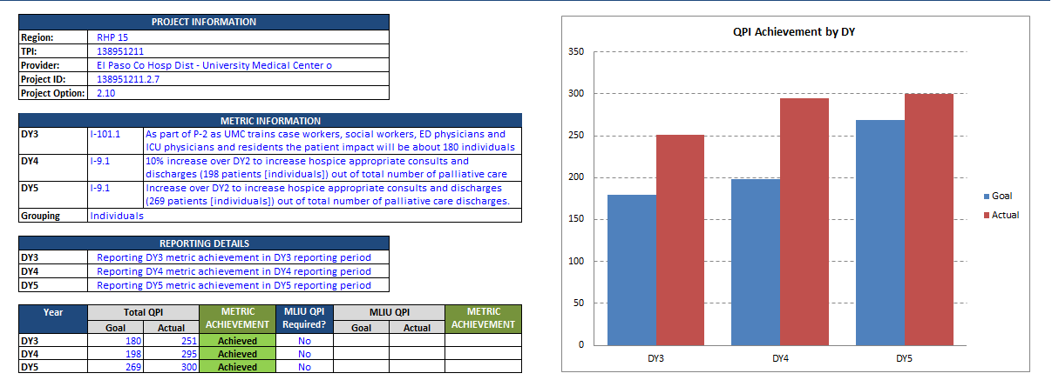
Quantifiable Patient Impact (QPI)

Slide 8
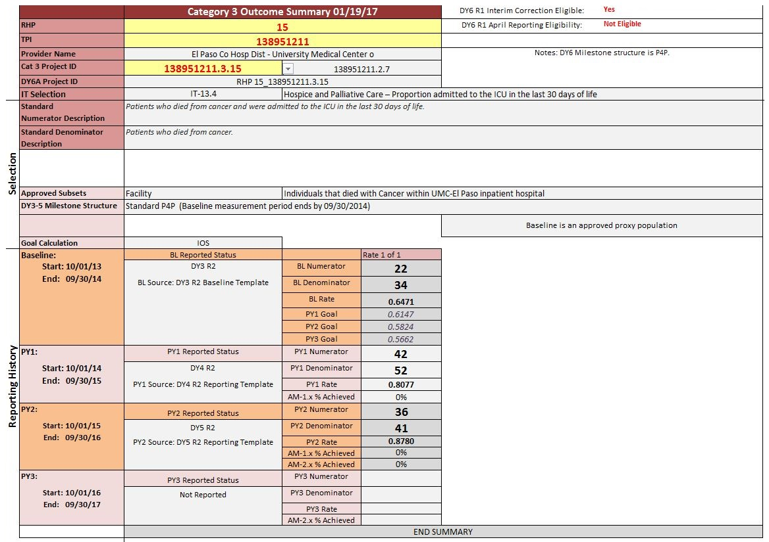
Clinical Outcome (Category 3)
($355,473.82)
$848,226.17
$848,226.17

Slide 9
NEW Cycle of dsrip - measure bundles
Improved Chronic Disease Management: Diabetes Care
Improved Chronic Disease Management: Heart Disease
Primary Care & Prevention - Healthy Texans
Primary Care & Prevention - Cancer Screening
Pediatric Primary Care
Improved Maternal/Perinatal Care
Improved Access to Adult Dental Care
Palliative Care
Care Transitions
Integration of Behavioral Health in a Primary Care Setting
Behavioral Health and Appropriate Utilization
Access to Specialty Care
Chronic Non-Malignant Pain Management
Hospital Safety

Slide 10
THANK YOU !

