Slide 1


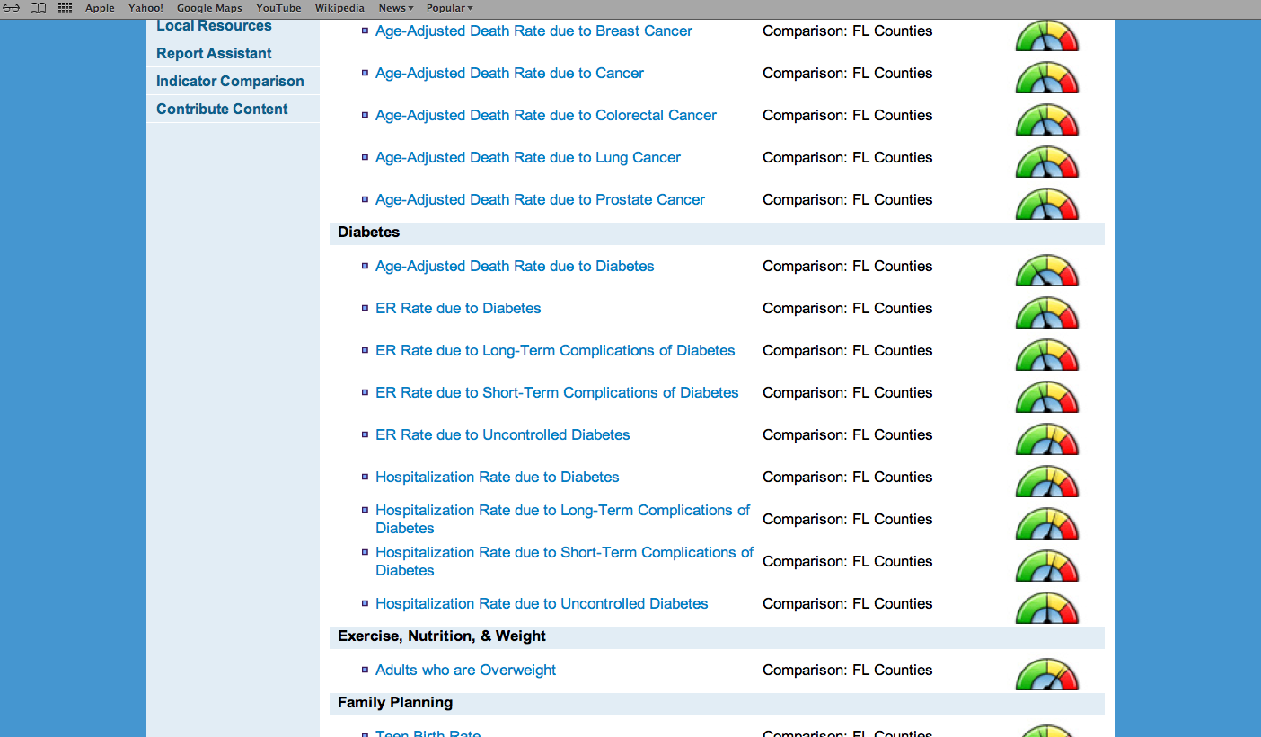
GIS Capabilities
City of El Paso
Department of Public Health
Region 15 Regional Health Partnership
1115 Healthcare Transformation Waiver
Health Information Exchange
Fernando J. Gonzalez, Lead Epidemiologist
Region 15 RHP Meeting
March 28, 2014

Slide 2
GIS Capabilities
Description of Project
Synopsis:
The Health Information Exchange (HIE) is a four year developmental effort to expand the Paso del Norte HIE through continued health department participation and promotion of the exchange.
Project Goal:
To facilitate exchange and centralized collection of health information through the HIE initiative.

Slide 3

Mission:
The mission of the Paso del Norte Health Information Exchange is to improve the quality, safety, access and efficiency of health care through privacy-protected exchange of personal health information in the PdNHIE region.
Participating Institutions:
-Paso del Norte Health Foundation
-Area hospitals
-El Paso County Medical Society
-El Paso First Health Plans
-City of El Paso Department of Public Health
- City of El Paso Fire/EMS Department??
-Texas Department of State Health Services ??
-West Texas HIT Regional Extension Center ??

Slide 4
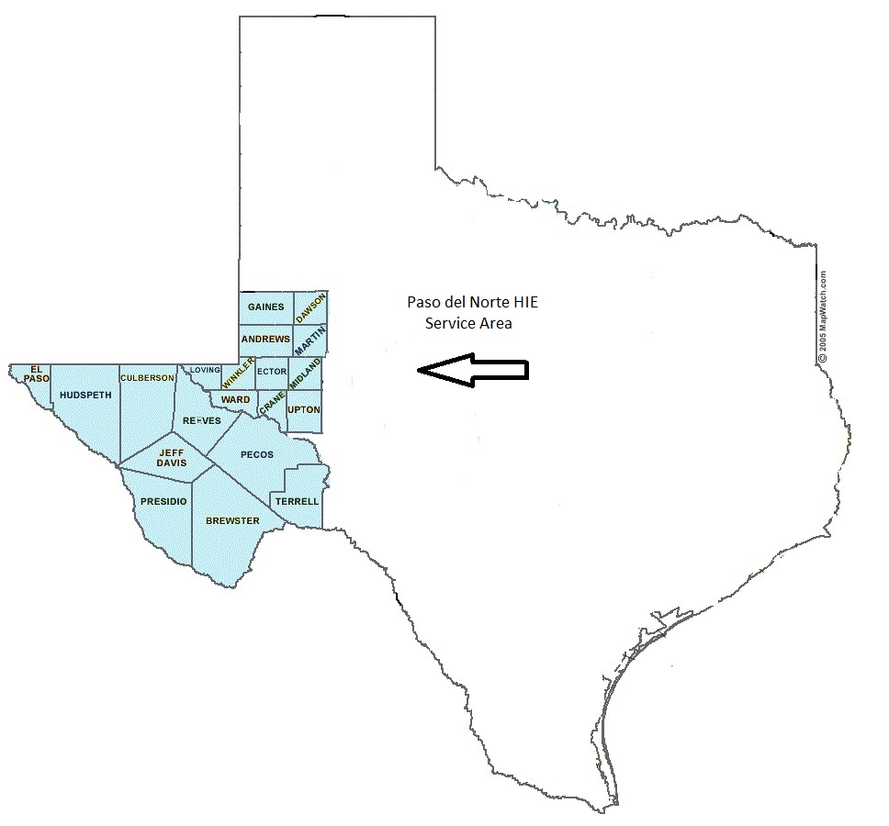

Slide 5
GIS Capabilities
Milestones and Progress
Milestone: Identify current capacity and needed resources
Critical staffing for project initiation to maximize efficiency.
-Health Project Coordinator
-Research Assistant
Paso del Norte HIE administrative infrastructure includes Executive Director; Marketing and Outreach Director; Office Manager

Slide 6
Milestones and Progress
Milestone:
Determine timelines and document implementation plans
HIE strategic plan development
Associate agreements are in the review process with each of the institutions.

Slide 7

Moving Forward…
Assess availability of health data from traditional and non-traditional sources
Address issues of inter-operability of databases
Continue engaging stakeholders by providing information about the data validation of the HIE
Inventory of data collection and procedures through site visits with participating institutions

