Slide 1
El Paso Fire Department
Deputy Chief R. Arvizu

Slide 2
DY2 Deliverables
Identify vaccinations and Screenings with the greatest likelihood to improve health and reduce transports and hospital admissions
Assess training needs
Protocols/Standing Orders
HIPAA
Databases
Health Message
Delivery of Services

Slide 3
Vaccinations and Screenings
Determined by Behavioral Risk Factor Surveillance System Survey
Through that survey and community risk assessment the following vaccinations and screenings will be offered
Influenza, Pneumococcal
Screening
Basic Health screening
Fecal Immunochemical Test (FIT)

Slide 4
Assess Training Needs
Provide a training session that will
Educate members on the program
History, examples of other departments and intent
How the program intends on providing this outreach and what tools they will have to complete the task
Cover the vaccines that will be administered
Screening, administration, documentation, and HIPAA requirements
A power point has been developed for a consistent and accurate representation to all members that attend the training
The program will be presented by our Infection Control Nurse and FRD staff

Slide 5
Training Needs
The class through the Continuing Education program of the Fire Department is being completed
The class started in March and will be completed by the end of April 2014
The target audience was department Paramedics

Slide 6
Protocols/Standing Orders
Protocols and Department Procedures have been developed
Submitted to Dr. Kenneth Berumen Medical Director
Awaiting approval or recommendations

Slide 7
HIPAA/Databases
Advise Patients of their rights and explain the intent of the program
Consent form needs to be obtained from the patient
http://www.aafp.org/fpm/2003/0200/p29.html
Electronic transmission of information will need to be encrypted

Slide 8
Develop and Test Health Message
This is being developed through the Department of Health and Fire Department
Gain attention to the program and its services to the target population
Las vacunas para la Salud/Vaccinations for your Health
Estación de vacunaciones/Vaccination Station
Testing the message will be done through survey of employees of the Department of Health and Fire Department

Slide 9
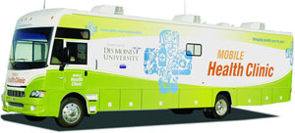
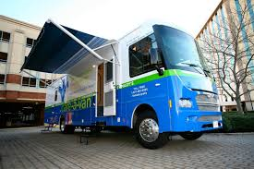
Delivery of Services

Slide 10
Questions?

