Slide 1


RHP 15 Collaboration
&

Slide 3
Patient Satisfaction Survey Results
Random Phone Survey: 18 patients
15 out of 18 Surveys resulted as very satisfied
3 out of 18 Surveys resulted as satisfied
18 out of 18 would recommend Tender Care Home Health
Example Comments:
“Very pleased with services”
“Nurse was very nice and polite, wonderful service”
“The nurse is very professional and helpful with her mother”
“Very pleased with all services”
“Nurse is great”

Slide 4
Project Development Updates
Diabetes and Coumadin clinic coordination
Ability to drop off labs at all UMC clinics
Appointments at UMC clinics
Collaboration with hospitalists
Bi-weekly meetings to improve discharges
Improved communication with UMC staff including pharmacist, case managers and social worker

Slide 5
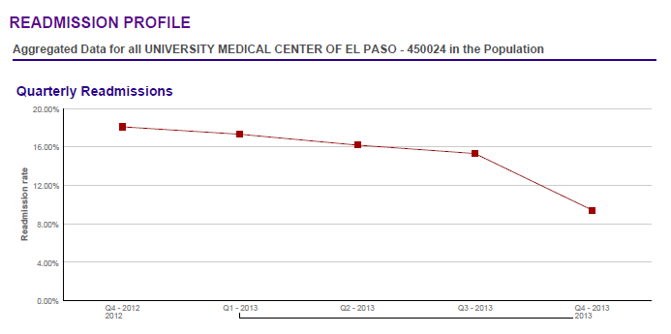
UMC Readmission Statistics

Slide 6

Salvation Army
This project will implement innovative evidence-based strategies in disease prevention areas.
The project aims to improve the health of the local homeless population, increase health awareness and knowledge, reduce the use of area emergency rooms, and implement the principles of preventative healthcare to the homeless population.
The project will reduce the number of patients who are admitted to the hospital as a result of difficulty managing chronic health conditions such as diabetes, obesity, and hypertension; the project will also reduce the use of emergency room visits by residents of the Salvation Army shelter by successfully managing their care on-site.

Slide 7

Rescue Mission
The Rescue Mission’s Nursing Program has been designed to provide primary and preventive healthcare to residents living at the Rescue Mission.
This is a population that generally encounters difficulty accessing healthcare, preventive services, and especially coordination of care.
This program also delivers education and support to empower them to gain control of their lives through disease management, medication compliance, appropriate diet and nutrition, and lifestyle changes.

Slide 8
Reduction in EMS Calls
Rescue Mission
1949 W. Paisano | 2012-2013 | 2013-2014
December | 12 | 7
January | 15 | 10
February | 7 | 4
March | 6 | 9
Total | 40 | 30
Salvation Army
4300 E. Paisano | 2012-2013 | 2013-2014
December | 6 | 3
January | 3 | 2
February | 3 | 1
March | 9 | 5
Total | 21 | 11

Slide 10
