Slide 1
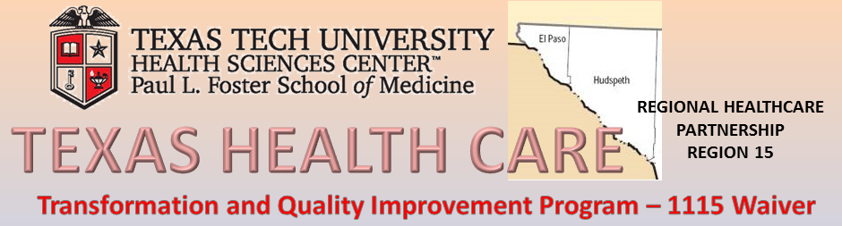
MINIMALLY INVASIVE GYNECOLOGY SURGERY FELLOWSHIP
Sandra Lopez, MD
Fellow Gynecology Oncology - Department of OB/GYN
El Paso First Health, 1145 Westmoreland Drive
Friday 11th, 2014 - 1:00pm

Slide 2

Description of the Project
AAGL approved Fellowship in MIGS
2 year program with 1 Fellow per year
Faculty preceptors from Texas Tech and the community
Supported internally by the Dept of OB/GYN
Milestones
Increase the number of residents choosing MIGS specialties (shortage).
Design workforce enhancement initiatives to support access to MIGS providers in El Paso region (underserved)
Expand MIGS training.

Slide 3

Benefits to the Community
Provide gynecologic services to patients at Texas Tech, UMC, Del Sol Medical Center and Las Palmas Medical Center
Production of an independent provider for the greater El Paso community
Increasing the pool of outside applicants to our Program and in turn, retention to the El Paso area
Benefits of minimally invasive surgery
lower incidence of site infections
smaller incisions and less scarring
shorter time in the hospital

Slide 4
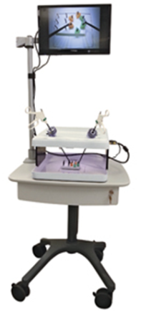
Progress
Milestones
Hyein Park, MD – New Fellow to start program July 2014
New training equipment to practice techniques outside of the OR
More patients have been seen each quarter since the program began
Risk Areas / Mitigation strategies
Faculty preceptors role as supervisors and mentors
Anticipated outcomes
Successful completion of an independent MIGS
Connection with other initiatives
Southwest Center for Reproductive Health
TX Gynecology and Laser Surgery Center

Slide 5
Innovations
Innovative ideas implemented
Advanced minimally invasive endoscopic instruments
Robotic technologies
Fellows can train using the da Vinci® Surgical System
Improvements to processes
Ability to apply MIS technology to patient care where the availability was scarce or non-existence
Using a mini laparotomy with an O ring wound retractor as a viable minimal invasive procedure in removing ovarian cysts

Slide 6

Questions?
Comments?

