Slide 1


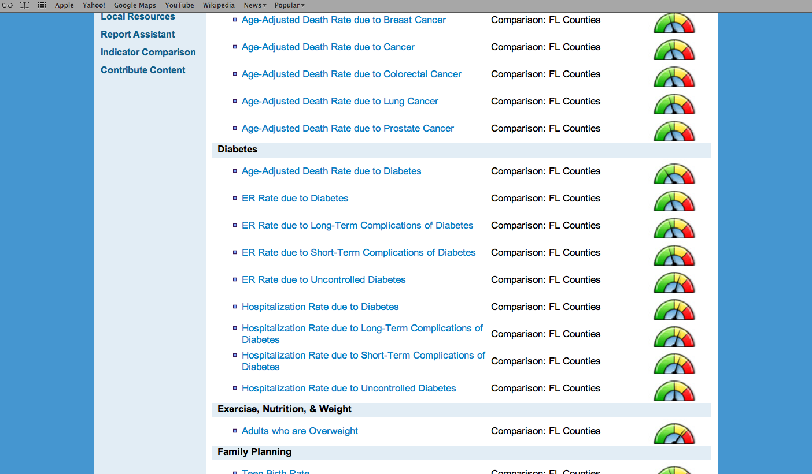
GIS Capabilities
City of El Paso Department of Public Health
Region 15 Regional Health Partnership
1115 Healthcare Transformation Waiver
Community Health Atlas
Fernando Gonzalez, Lead Epidemiologist
Region 15 RHP Meeting
August 24, 2014
1:00pm

Slide 2
GIS Capabilities
Description of Project
Synopsis:
The Community Health Atlas is a four year developmental effort to capture disease and health condition REAL data from existing and supplemental databases then map the data for informing of policy makers, planners, researchers and interested public.
Participating Institutions:
-City of El Paso Department of Public Health
-City of El Paso Fire/EMS Department
-area academic institutions
-hospitals/health centers/insurers
-Paso del Norte Health Information Exchange

Slide 3
GIS Capabilities
Innovation
Display/layer REAL data at zip code level for informing policy makers and health advocates
Identify data repository participants and extended family members in need of preventive health services, e.g. breast and cervical cancer screening; refer to medical home and follow up or provide needed screenings/immunizations

Slide 4

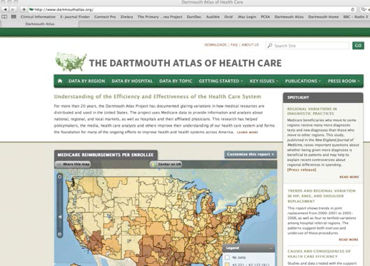
ATLAS Healthcare Mapping Model
1993-Developed from Clinton Health Care Reform
National reporting of health system performance over time in utilization, cost, quality, and patient experience.
Data to effect positive changes in the health care system.
Funded by
Robert Wood Johnson Foundation
California HealthCare Foundation
Charles H. Hood Foundation
www.dartmouthatlas.org

Slide 5
GIS Capabilities
Progress
Milestones status:
Determined content for data repository
-DPH Medicaid Waiver Projects
-Biomarker Data
-REAL Survey Standardization
Engagement of Dartmouth Institute as project collaborator in a joint effort with Texas Tech University Health Sciences Center
Business plan for collection of biomarker data
Hired Database Administrator

Slide 6
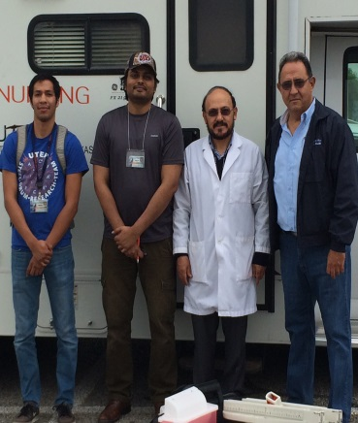
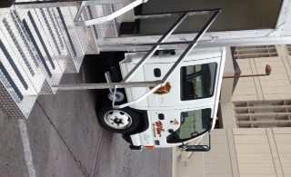
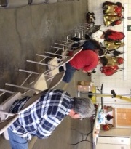

GIS Capabilities
Progress
Medicaid Waiver Projects Status:
Agreements with area universities for Border Public Health Interest Group
UTEP and Neighborhood Fire Station Pilot on Saturday, September 20
Collaborating with PdNHF Health Information Exchange
Standardized REAL Data Survey Collection
Distribution of Vouchers
Continuing with Mobile Dental Unit Services
Solicitation for Preventive Care Services to local providers for: mammography, Pap tests, FOBT

