Slide 1

DSRIP LPDS CHF PROJECT

Slide 2

LPDS CHF Project
Category: Expand Chronic Care Management Models
Implementation: LPDS has established Heart Failure clinics between the two hospitals. The project established a registry for heart disease patients.
Description: The HF clinics are outpatient clinics offering a comprehensive, multidisciplinary approach to patient care to improve long-term outcomes.

Slide 3

LPDS CHF Project
Project goals:
Promote patient education and self-care
Reduce readmission rates
Improve patient compliance through prescribed medical therapy
DSRIP Metrics-Baseline was zero
DY3 Goal: Enroll 250 patients
DY4 Goal: Enroll 1,200 patients
DY5/DY6 Goal: Enroll 2,100 patients

Slide 5
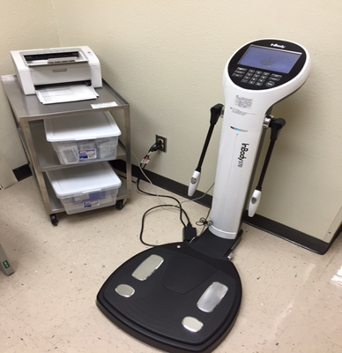
Heart Failure Program
After discharge, comprehensive exam by nurse practitioner and RN Coordinator to include:
Complete physical examination
Complete medication evaluation
Weight monitoring
Fluid balance by In-Body analysis
In-depth disease management education
6 minute-walk-test
Laboratory work is drawn as needed
Weight scales available for home use
EKG if needed
Incorporate exercise program (*stages HF in progress)
Notes:
Upon discharge home, telephone call to patient by RN Navigator
Patient identified while hospitalized by Cardiology NP and RN Navigator during rounds, introduce information to patient and family concerning HF clinic, share HF education booklet and schedule referral appointment prior to discharge
Building block to improve outcomes with in-depth disease management and nutrition education
HF clinic referral/notification faxed to clinic with recent ECHO and BNP
Follow up appointments weekly x 1 month then monthly
Patient visit progress note/evaluation sent to PCP and Cardiologist

Slide 6
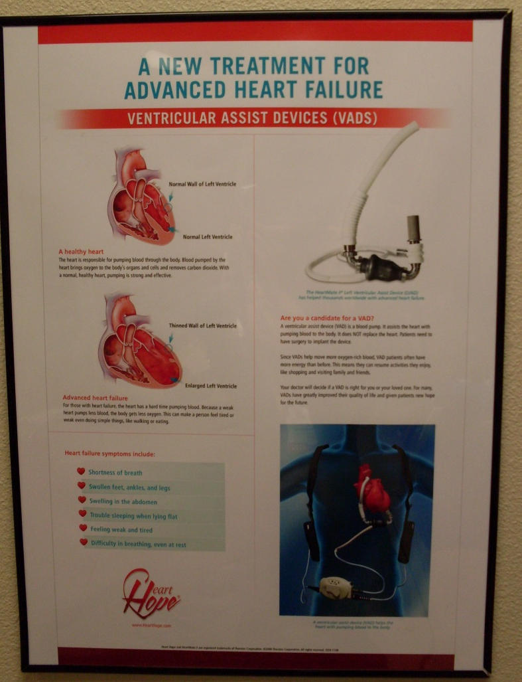
Las Palmas Heart Failure Shared Care Clinic
• VAD patients currently seen in clinic: 11
LVAD: 9
HVAD: 2
Commitment of a designated VAD team that includes:
supervising cardiologist *Champion Physician
advanced practice nurse coordinator
• Purchase and maintenance of equipment
System monitor, batteries, controller, and power cable
Driveline management (dressing) supplies
• Regular, easily accessible bidirectional communication between implant center and the shared-care site

Slide 7
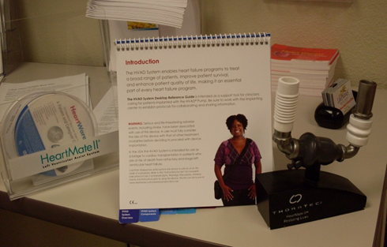
Las Palmas Heart Failure Shared Care Clinic
Organize and participate in continuous education:
Clinic VAD team to attend LVAD/HVAD seminars regularly
In-service to first-responders on LVAD/HVAD emergency care
Local cardiology clinic staff education
WBAMC Cardiology Clinic
El Paso Cardiology Associates
Las Palmas Medical Center staff education
ER, ICU and Telemetry units
Notes:
-In-service first-responders on LVAD/HVAD emergency care (September 28 & 29th 2016)
-WBAMC –(September 29, 2016))
-El Paso Cardiology Associates (October 19th, 2016)
-Las Palmas Medical Center staff education (Upcoming inservice in November)
ER, ICU, Telemetry units

Slide 8
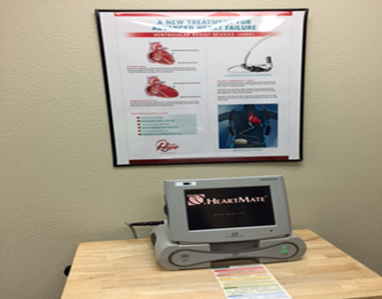
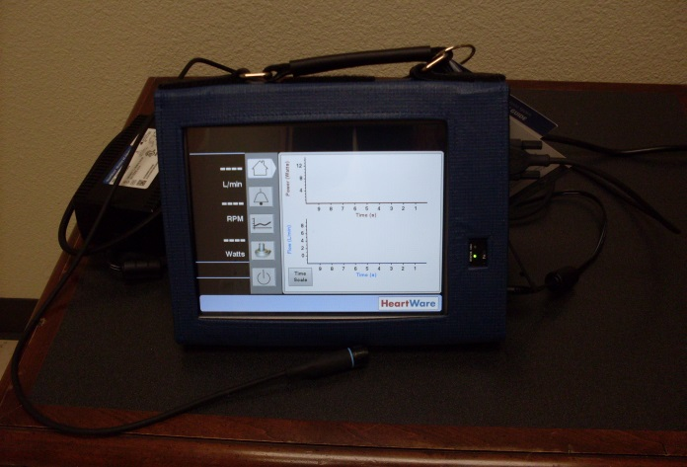
Las Palmas Heart Failure Shared Care Clinic Heart Mate II Monitor /Heart Ware Monitor
Heart Mate II monitor for LVAD Patients
Heartware monitor for HVAD patients
Waveform data collection
Collaborate with implanting center
*Medcity
*Houston Methodist
* Hermann Memorial Houston
* St Luke’s Houston
*Temple Texas
*Baylor Dallas
*San Antonio Methodist
HeartMate II Monitor
HeartWare Monitor

Slide 9
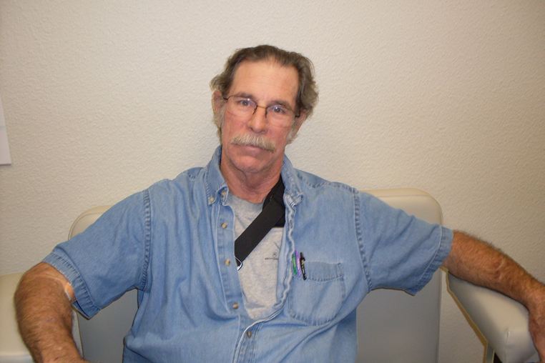
Las Palmas Heart Failure Shared Care Clinic Success Story
Michael Bauer
LVAD recipient August 7, 2015 Memorial Herman

Slide 11
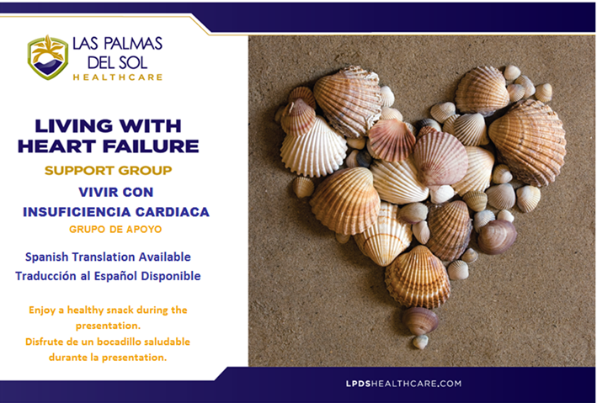
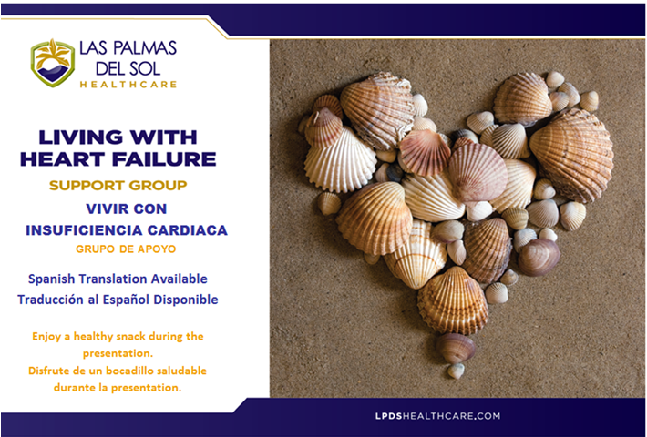
Community Service Support Group Living with Heart Failure
Patients discharged from the hospital with a diagnosis of Heart Failure receive an invitation to attend the Support Group.
A core group of clinical people including: nurses, dietitians, and behavioral health professionals present important and helpful topics.
During the presentation we provide food that meets the needs for our Heart Failure community.
Recipes of the prepared food with portion sizes and nutrition facts are available.
Patients and family members have the opportunity to socialize and share experiences.
Clinical Staff available for personal questions or concerns after the presentation.
Notes:
Disease process
Self care
Emotional Health
Dietary recommendations
PURPOSE: To help patients and their family members manage their stress and heart failure.

Slide 12
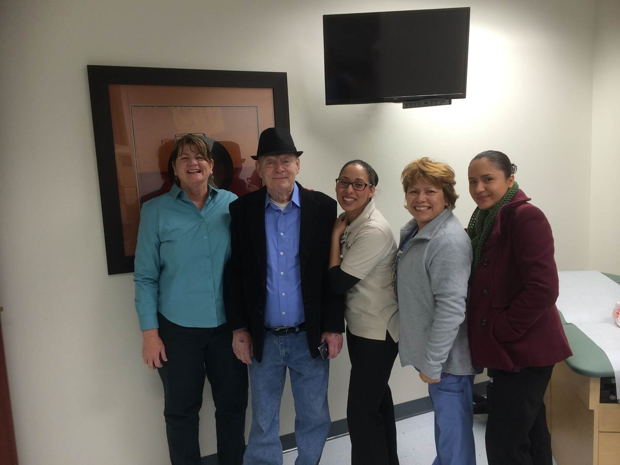
Del Sol Heart Failure Clinic Mac’s Story
Mr. Mac was referred to Del Sol Heart and Valve Clinic after 15 Heart failure admissions to Del Sol Medical Center in 2015.
For the first time in the last 3 years, he was out of the hospital for 5 consecutive months.
2 Heart Failure admissions in 2016.
This is his story:

Slide 13



