Slide 1
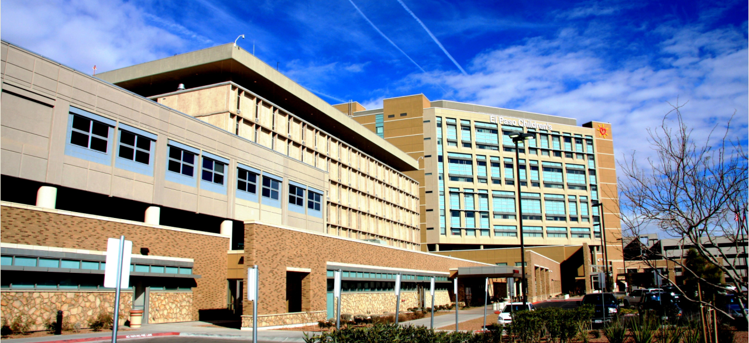

Nurse Residency/Simulation Program
Lorrie Giessel, MSN, RN
Julie Gest, MS, RN
Region 15 RHP Meeting
June 26, 2014

Slide 2
Institute of Medicine
One of the eight recommendations on improving the future of healthcare
Hospitals and educators need to implement a Nurse Residency Program (NRP) for Graduate Nurses (GNs)
Why Implement a Nurse Residency Program?
The Problem
High Stress
Accelerating Nursing Shortage
High Costs
The Consequences
Nurse Burnout
Compromised Patient Care
Lower Revenue

Slide 3
The Problem
High Stress
High acuity environment
Lack of situational experience
High risk factor for patient safety and practice errors
Leads to high nurse turnover
Median voluntary turnover rate of their license for first year RNs
27%
Accelerating Nursing Shortage
2012-Nurses between the ages of 50-60 make-up the largest demographic group in the nursing workforce
2014-need to recruit more than 400,000 new RNs to replace those expected to retire
Estimated by 2025
Shortage of 500,000 nurses

Slide 4
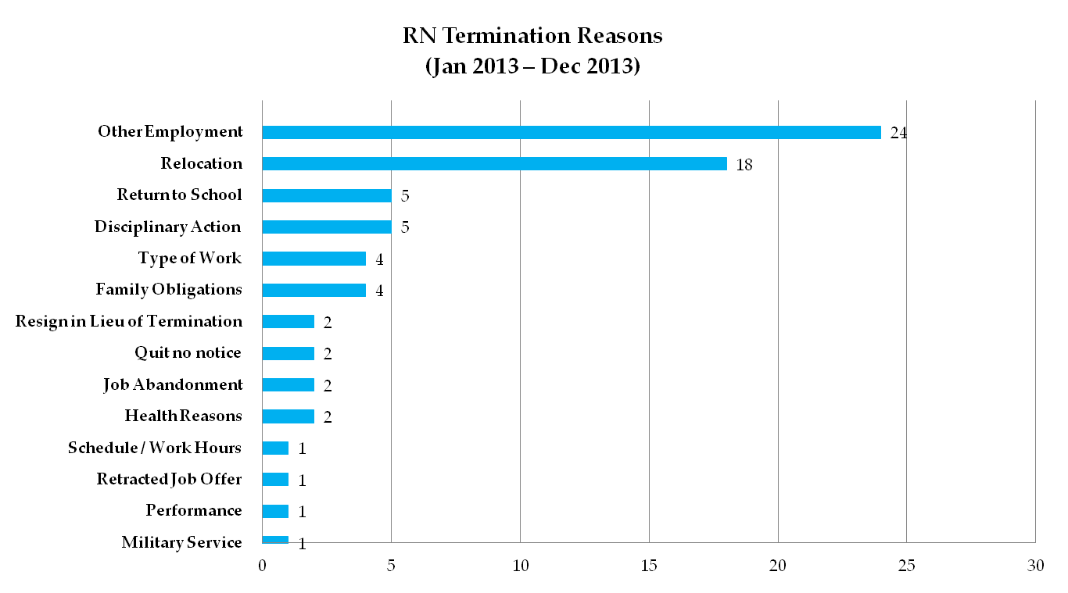
Reasons for Turnover

Slide 5
High Costs
Average cost related to nurse turnover
$88,000 per nurse
Healthcare organizations spend an estimated $300,000 in nurse turnover costs for every 1% increase in turnover
Decreasing revenue and increasing overall expenses for the Hospital
PricewaterhouseCoopers Health Research Institute

Slide 6
Consequences
Nurse Burnout
Hospitals with a nurse-to-patient ratio of 1:7 had an average turnover rate of 18%
Hospitals with a ratio of 1:4 averaged only 9%
Compromised Patient Care
40% of GNs report making medication errors
51% of GNs may fail to recognize life-threatening complications due to lack of situational experience
Journal of Advanced Nursing found “The adequacy of nurse staffing and proportion of RNs is inversely related to the death rate of acute medical patients within 30 days of hospital admission.”
Lower Revenue
Centers of Medicare & Medicaid Services
Non reimbursable conditions are directly linked to quality of care delivered to the patient at the bedside

Slide 7
Description of the Project
The Nurse Residency and Simulation Lab will create a safe environment for the primary care nurses to practice and to observe their competency in performing correctly, effectively and safely.
Assist in the transition from the student role into the professional nurse role
All these improvements will ensure positive healthcare outcomes, and highly-specialized and safe patient care.

Slide 8
Description of the Project
Ensure an organized structure of learning and training
Primary focus will be on the following:
Prioritization of abilities
Communication skills
Critical thinking skills
Leadership skills
Decision making skills
Clinical practice skills
Holistic care
Focus on improving overall retention of nurses

Slide 9
Project Plan
Implemented UHC/AACN Nurse Residency Program
Hired:
Nurse Residency Program Coordinator
Manager of Simulation
Hired unit-based Nurse Educators
Educating All Directors/Nurse Managers/HR Associates/Fiscal/IT/Ancillary Services

Slide 10
Goals
To increase nurse retention
To produce quality nurses through the 1-year Nurse Residency Program
To improve patient outcomes through education and simulation
To expand the number of specialty nurses in their area of expertise

Slide 11
Milestone DY2:
Conducted primary care gap analysis
The purpose of the gap analysis was to reveal the perceived lack of knowledge, skill, practice and critical thinking skills of graduate nurses by their nursing peers and nursing management at the University Medical Center of El Paso.
Goal Met

Slide 12
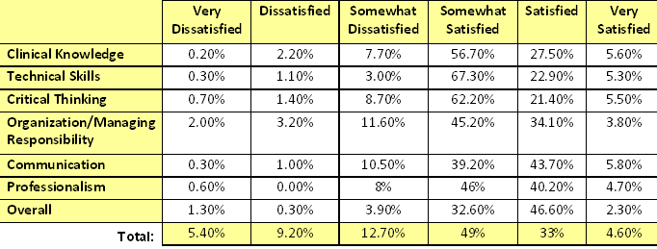
Results of Gap Analysis

Slide 13
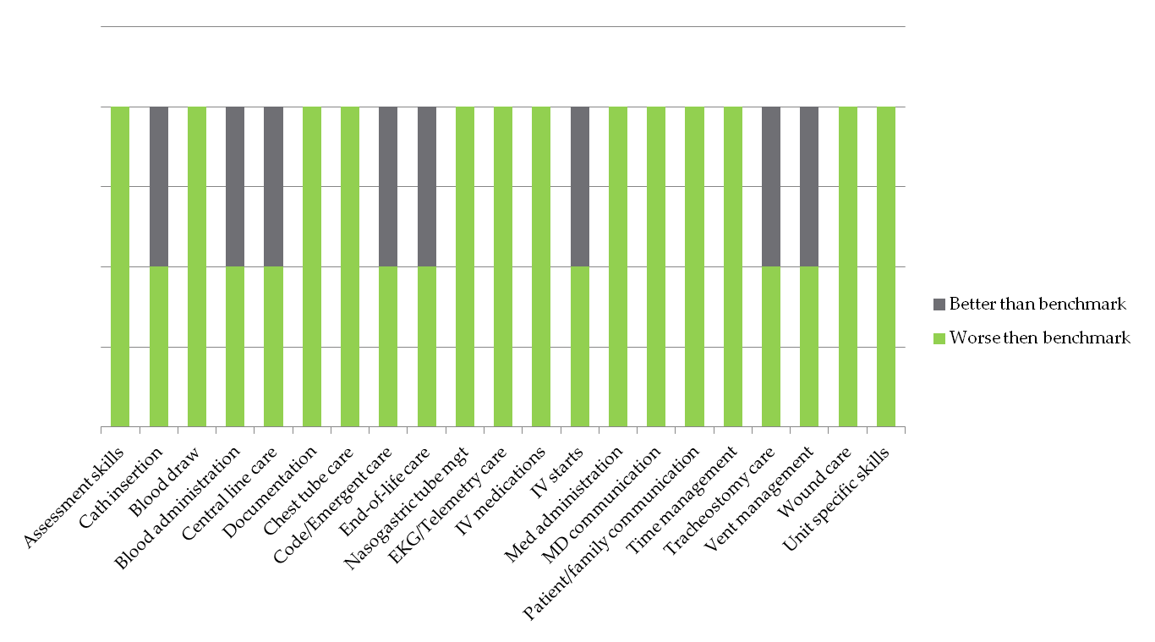
Gaps – Identified by New Nurses
Initial Casey Fink Survey 03/2014

Slide 14
Strategy
Nurse Educators specializing in the following areas:
Emergency Department-Ann Gomez
Operating Room-Carmina Rafin
Intensive Care Unit-Sandra Henderson
Endoscopy/GI-Lisa Osborn
Acute Care Elderly-Cheryl Simpson
Medical Unit-Diana Bowen
Surgical Unit-Phyllis Wells
Mother Baby-Meghan Robinson
Cardiovascular/Telemetry/IR (vacant)
Dedicated 1/3 of their time to the Residency Program

Slide 15
Milestone DY3
Expand Graduate Nursing Care Providers
Hired 20 Graduate Nurses (Metric-15 Graduate Nurses)
Calculated total number of patients seen by the Nurse Residents per day
Nurse Resident encounter
4,620 Nurse Resident encounters
As of May 2014
2,810
Average of 1,000 Nurse Resident encounters/month

Slide 16
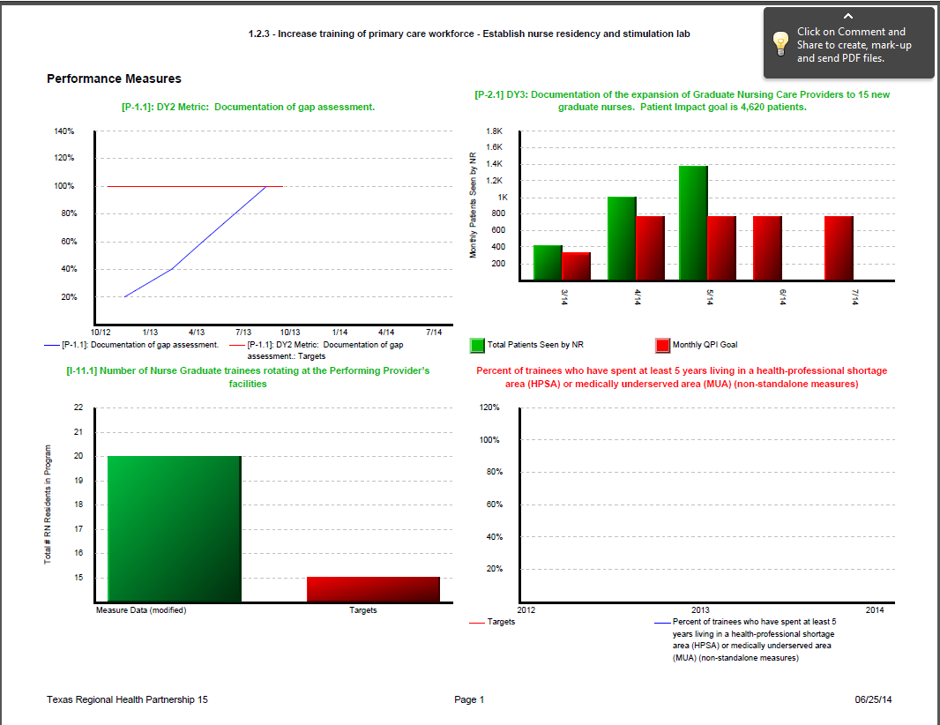
RAT

Slide 17
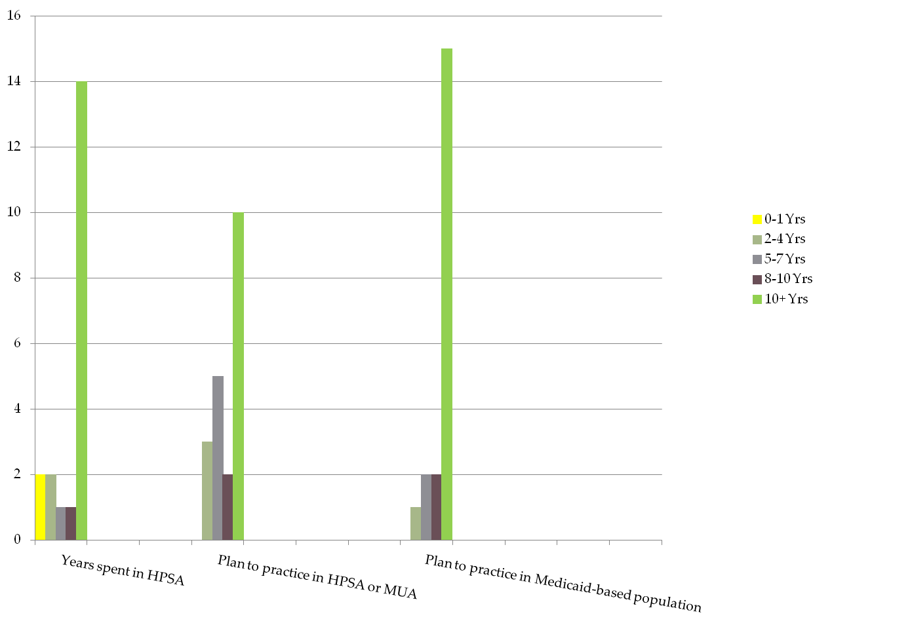
Survey

Slide 18
Risk Areas
Hiring qualified personnel
Management
Nurse Residency Program Coordinator
Specialty Nurse Educators
Implementation of program
Unanticipated internal processes not congruent with the project
Space
Paradigm Shift
90 days orientation to 1 year Nurse Residency

Slide 19
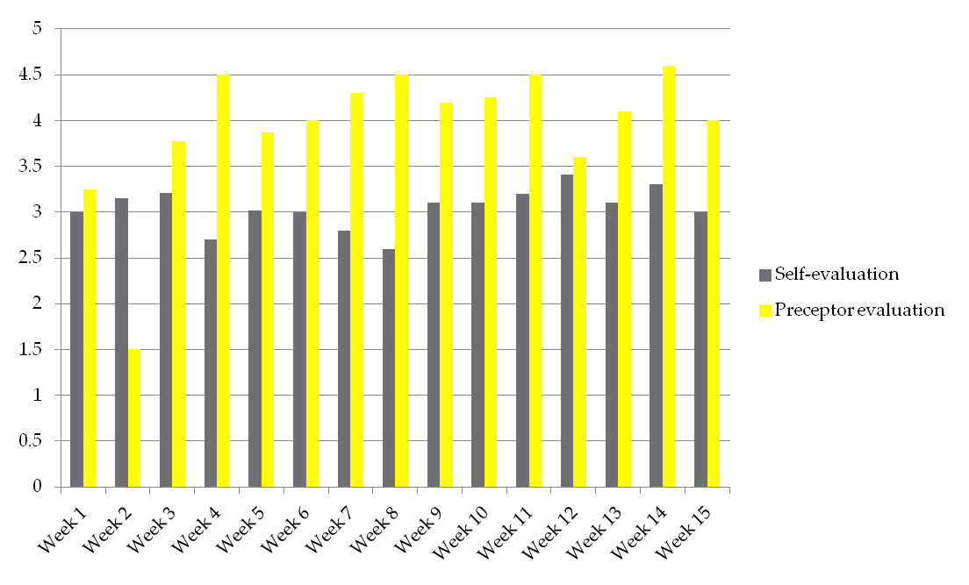
Strategy
Journaling – Both Preceptor & Preceptee

Slide 20
Benefits to the Community
This project meets the regional goal of increasing the number of specialists (RNs) and scope of specialty services offered at the community based hospital.
Implementation of evidence-based projects
Improve overall nursing care-short term
Sharing of outcomes to institutions within the region-long term
Enhance collaboration between affiliating agencies by exchanging current evidence-based educational practices
Increase total number of overall qualified nurse providers

Slide 21
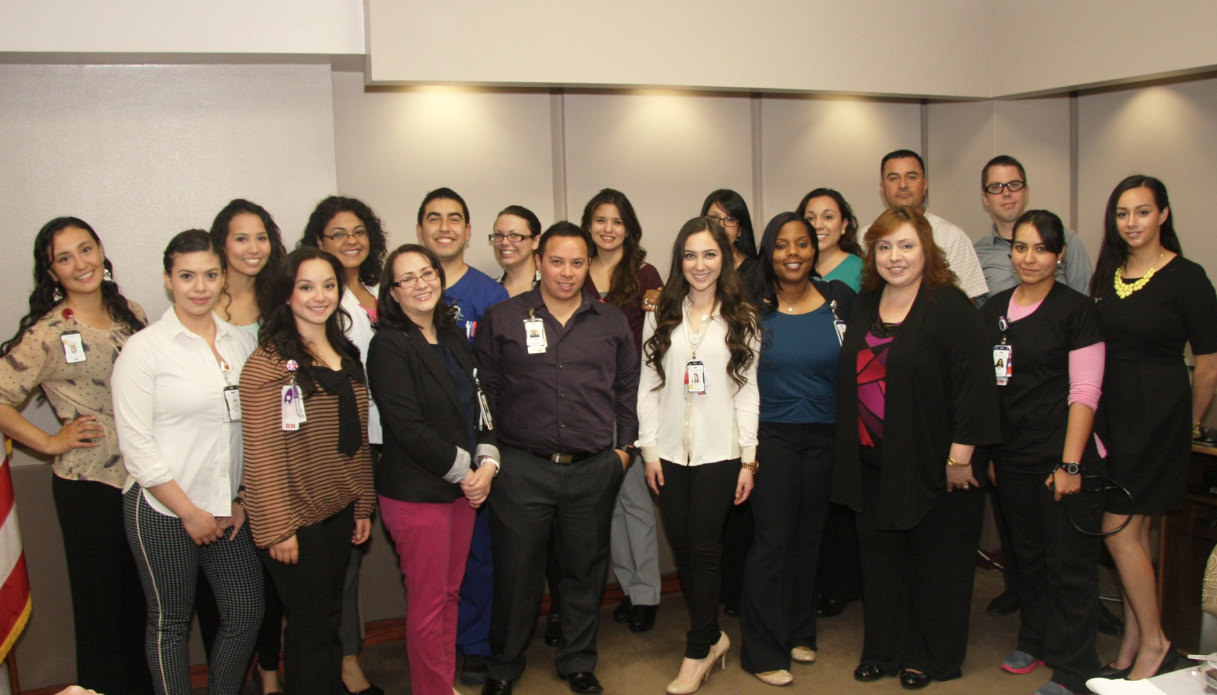
Nurse Residents–Cohort I
Nurse’s Week Mayoral Proclamation
May 6, 2014

Slide 22
Thank You

