Slide 1
El Paso Fire Department
Assistant Chief M. D’Agostino
Deputy Chief R. Arvizu

Slide 2
Overview of the Project
Development of Immunization and Health Screening

Slide 3
DY2/DY3 Deliverables
Assess training needs
Provide Training needed for Department Paramedics
Health Message
Protocols/Standing Orders
HIPAA/Databases
Purchase field and Fire Station equipment and Supplies
On site Delivery of Services
Retrofit of Fire Station
Pilot Program in two high need area neighborhood Fire Stations

Slide 4
Training needs
Train Department Paramedics
To have pool of Medics for staffing two teams
The class is scheduled to begin in May
This is the beginning of our next 6 month training session
The intent is to training all of our Paramedics during this block
Greater pool of personnel that can be drawn on
As stated previously we can train Staff and ROC paramedics to have an immediate team available
The intent is to get by in and develop confidence in our abilities to make an impact

Slide 5
Protocols/Standing Order
The Immunization/Medication Distribution Protocol will be delivered to the Medical Director
The will be accomplished prior to any training.

Slide 6
HIPAA
The collection and use of patient information will require HIPPA distribution and record keeping.
Create an electronic copy of the health screening form
That is electronically encrypted
Database that is shared between agencies
Provide the screening locations with toughbooks for documentation

Slide 7
On site Delivery of Services
The design or Retro Fit of Station will be driven by the required use of the space.
It would need to be a clean environment that is not currently used for living or storage.
It would require amble room for staff and client
Basic formula 15 sqft per person
1 emergency exit for occupancy of 49 or less
2 staff members and 1 one client would require at minimum 45 sqft.
Fire Station Bays could be used for waiting areas
And meet any applicable Building or Fire Codes
Renovating or adding on to existent buildings

Slide 8
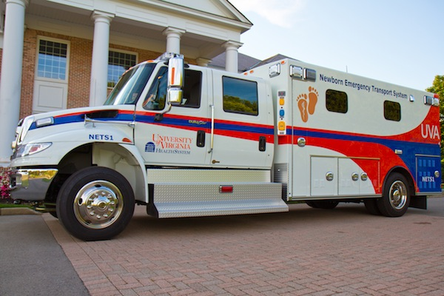
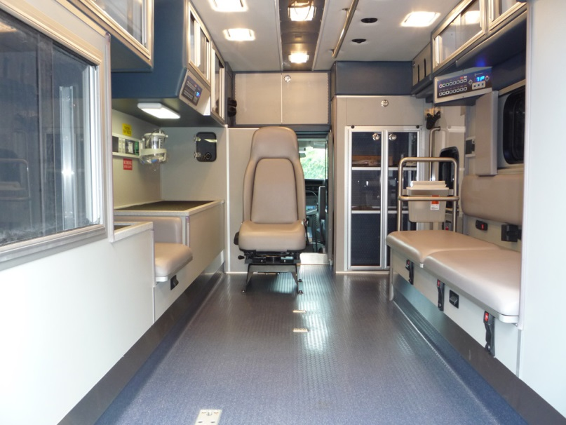
Options for Onsite Delivery of Service
Use of Specialty Rescue or MICU units that can be posted within the Fire Station Bay during Health Screenings
Units will be specked out to provided need space for standing, wheel chair access and seating.
Are Mobile
Can be labeled to identify the program and advertising
Station Bays can still be utilized for waiting areas
Units can be spec out with lifts
Cost are driven by the specification of the unit being ordered

Slide 9
Pilot Program in two high need area neighborhood Fire Stations
High rates of Medicaid and Uninsured
Billing data for 2012 and 2013 was used to cluster this information by Zip Code
With this information target stations where identified for those clustered zones

Slide 10
Summary of Insurance Clustering
Stations identified as possible pilot location sites using Medicaid as the determining factor
79901
Central or Fire Station 11
79924
Fire Station 23
79936
Fire Station 25
79907
Fire Station 18
79915
Fire Station 17
Stations identified as possible pilot location sites using Unknown/Uninsured as the determining factor
79901
Central or Fire Station 11
79936
Fire Station 25
79924
Fire Station 23
79907
Fire Station 18
79925
Fire Station 20

Slide 11
Questions?

