Slide 1

City of El Paso
Department of Public Health
Region 15 Regional Health Partnership
1115 Healthcare Transformation Waiver
RHP 15 Meeting
3/25/3015
Nick Emerick, MA

Slide 2
REAL Data
Race, Ethnicity, and Language collected with other demographic data
  Collection interests of all stakeholders
Collection instrument standardization
Collected with surveys during the intake process
Standardization allows for combining across four projects

Slide 3
Background
Data collection used as a screening process for services
Participating Institutions
  UTEP
  UTH
  Texas Tech
  Fire Department
  DPH Preventative Medicine Clinic

Slide 4
Border Public Health Interest Group
A collaborative with local universities
  Flu, pneumonia, and HPV vaccines
  Cancer screenings
  Environmental assessment
  Health Classes
Cancer screenings currently in contract reviews
Developed Voucher System
Working with housing authority

Slide 5

Expansion of Oral Health Services
Offers dental check-ups for persons 21 and younger.
Financial assistance available for uninsured and low-income persons.
Mobile unit deploys to local Head Start locations
Has served 65% Medicaid and 35% uninsured

Slide 6
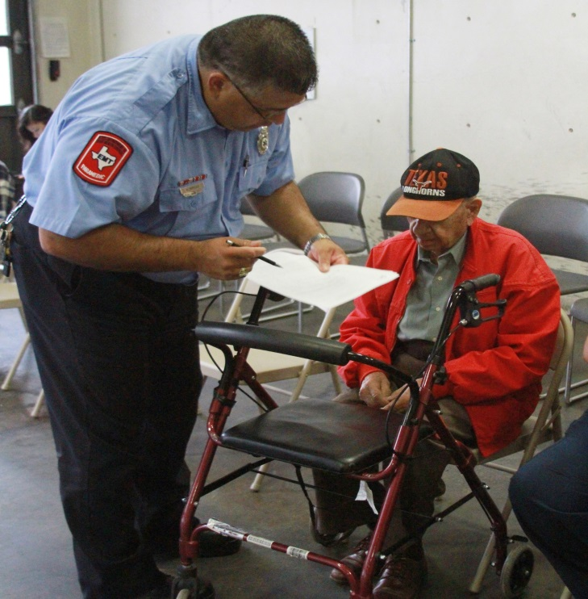
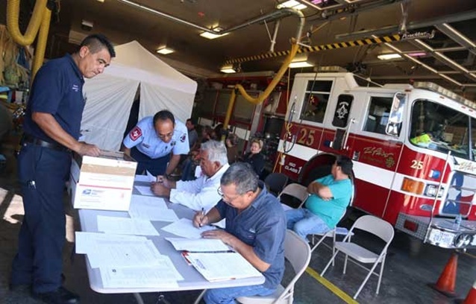
Neighborhood Fire Stations

Slide 7

El Paso Community Health Atlas
Web-based application to map health of community
Identify locations where health services are needed
  STD testing
  Flu and pneumonia vaccines
  HPV vaccines
  Cancer screenings

Slide 8
Challenges and Opportunities
Health Information Exchange
  Hospital Agreements
  Collaborating with local hospitals for baseline data
Low Voucher return rates
  Possibly undercounted
  Most common issues with schedule or transportation
  Can be mitigated by on site services delivery
Ongoing negotiations for cancer screening providers

