Slide 1

DY7 PFM & Bundle Protocol
The rules….

Slide 2
REVIEW DY7-8 Proposal
Additional 21 months of funding
Uncompensated Care (UC) pool
DSRIP pool
Managed Care provisions
Same funding levels (no increase – no decrease)
STILL negotiating with CMS
Approval for DY7-DY8 expected in August 2017
New updated RHP Plan
Explain transition from old projects to new core activities
HHSC Needs Feedback on Bundle protocol by July 7th
https://www.surveymonkey.com/r/W6MC9LL

Slide 3
REVIEW DY7-8 Proposal
RHP Plan Update (due January 2018)
Updated Community Needs Assessment
Stakeholder Engagement Event
Population by Provider (PPP) Baselines
Measure Bundle Selections
Transition of Projects to Core Activities
Description of Planned Core Activities
Valuation Amounts
Signed Certifications from Leadership

Slide 4
NEW Categories
Category A – Core Activities
Progress on core activities
Alternative payment model arrangements
Costs and savings
Collaborative activities.
Category B - Medicaid and Low-income or Uninsured (MLIU) Patient Population by Provider (PPP)
Category C - Measure Bundles
TBD
Category D - Statewide Reporting Measure Bundle
similar to hospital Category 4 reporting

Slide 5
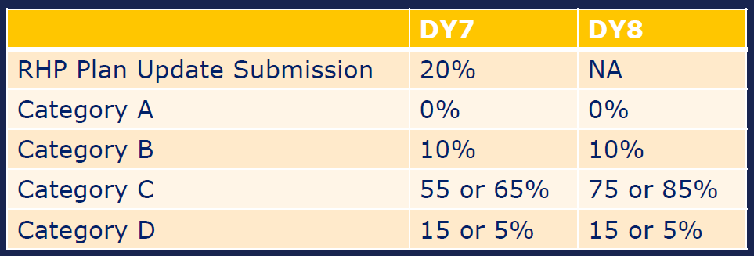
Funding Levels by Category
**If private hospital participation minimums in the region are met, then Performing Providers may increase the Statewide Reporting Measure Bundle (Cat D) funding distribution by 10%.

Slide 6
Category A Requirements
Report to include:
Core Activities
Progress and updates on all activities
Alternative Payment Methodology (APM)
Progress toward OR implementation of APM arrangements with:
Medicaid Managed Care Organizations (MCOs)
Other Payors
Costs and Savings
Submit costs of core activities
Forecasted/generated savings experienced from the activities
Collaborative Activities
Required to attend (each DY)
Learning Collaborative (at least one)
Stakeholder Forum
Or other Stakeholder Meeting

Slide 7
Category B – System definition
YOU will define your “system”
System definition is intended to reflect the “universe of patients served by a performing provider”
Should incorporate ALL components of the organization that serve patients
There are REQUIRED and OPTIONAL components
REQUIRED are considered the essential or “base unit” functions (or departments) of the provider
If the provider system has that business component it must be REQUIRED

Slide 8
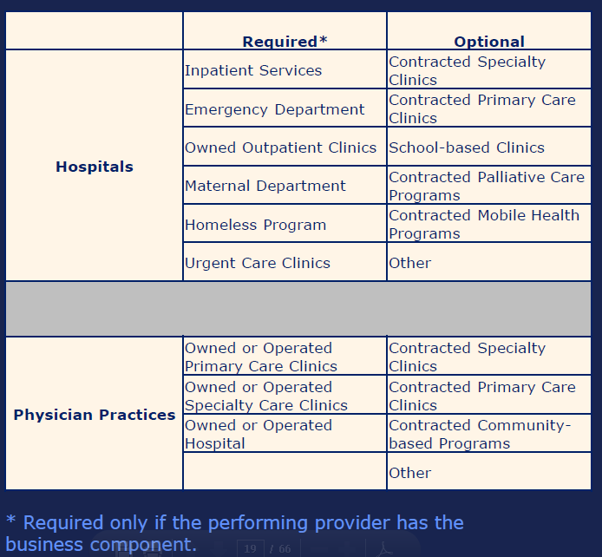
Category B – System definition

Slide 9
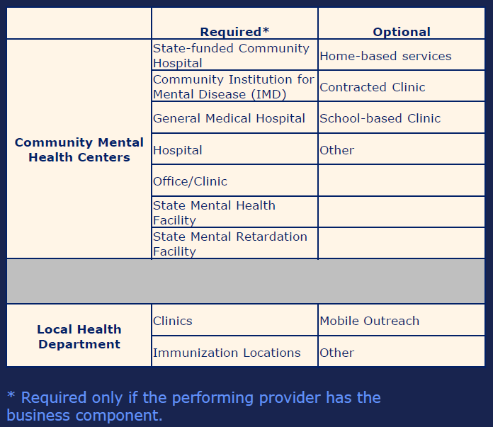
Category B – System definition

Slide 10
Category C Requirements
144 measures TOTAL
ALL are P4P (unless listed as “innovative measure”
Some measures are in MULTIPLE bundles
NOT considered double dipping
Compendium Documents (Specifications) WILL be updated
Can reference NQF standards
CMHCs and LHDs will select measures rather than measure bundles.
CHMCs and LHDs must select at least one 3-point measure.
Exception for depression response measure: If a CMHC selects more than one of the depression response measures M1-165, M1-181, or M1-286, only 3 points will be counted towards the Performing Provider’s MPT.

Slide 11
Category C Requirements
MEASURE BUNDLES
Improve Chronic Disease Management: Diabetes Care
Improve Chronic Disease Management: Heart Disease
Improve Maternal/Perinatal Care
Primary Care & Prevention: Healthy Texans
Primary Care & Prevention: Cancer Screening
Hospital Safety
MEASURE BUNDLES
Pediatric Primary Care
Improve Access to Adult Dental Care
Palliative Care
Care Transitions
Integration of Behavioral Health in a Primary Care Setting
Behavioral Health and Appropriate Utilization
Access to Specialty Care
Chronic Non-Malignant Pain Management

Slide 12
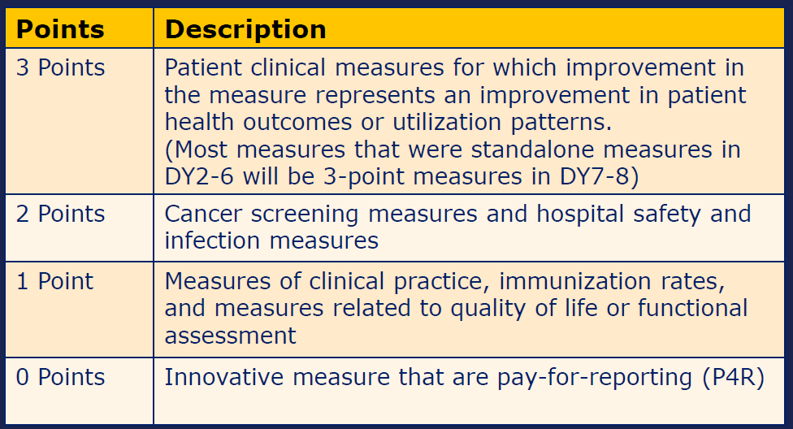
Point System

Slide 13
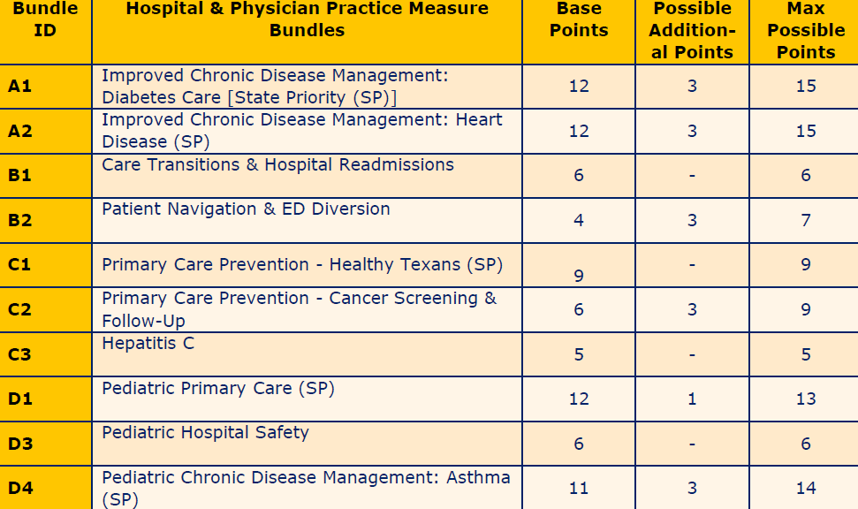
Point System

Slide 14
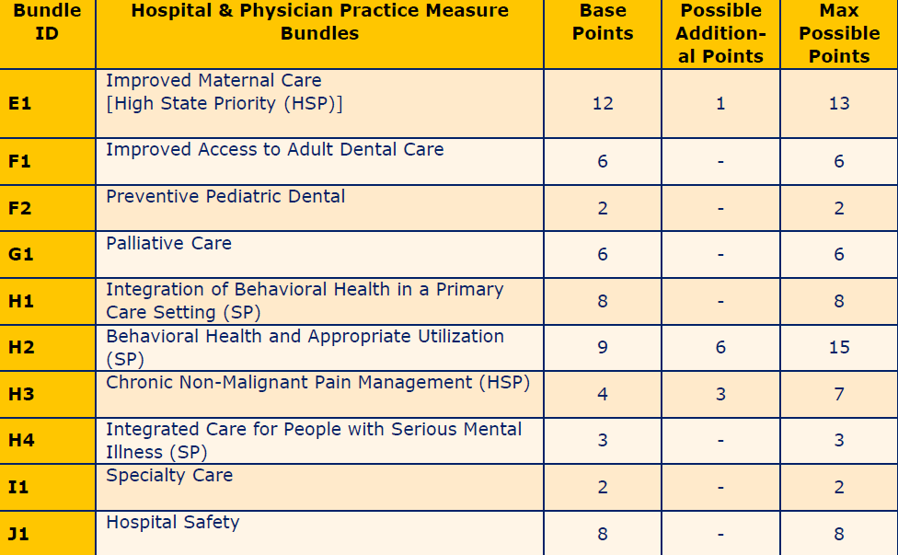
Point System

Slide 15
Minimum Bundle Selection
If you have a valuation of more than $2M per DY
MUST select bundle with REQUIRED 3 point measure
MUST select bundle with OPTIONAL 3 point measure
Following bundles must be selected in ADDITION to a bundle with a 3 point measure
C1: Healthy Texans
C3: Hepatitis C
D3: Pediatric Hospital Safety
F2: Preventive Pediatric Dental
G1: Palliative Care
H4: Integrated Care of People with Serious Mental Illness
I1: Specialty Care
J1: Hospital Safety

Slide 16
Bundle Valuation
Calculate total Category C valuation
Total DY7 Valuation X 0.55 (or 0.65)
Calculate MIN and MAX for each Bundle
MINIMUM = (A/B)/2 * Category C valuation
MAXIMUM = (A/B) * Category C valuation
A = Measure Bundle Point Value
B = Sum of all SELECTED Measure Bundle Points
Distribute to Bundles

Slide 17
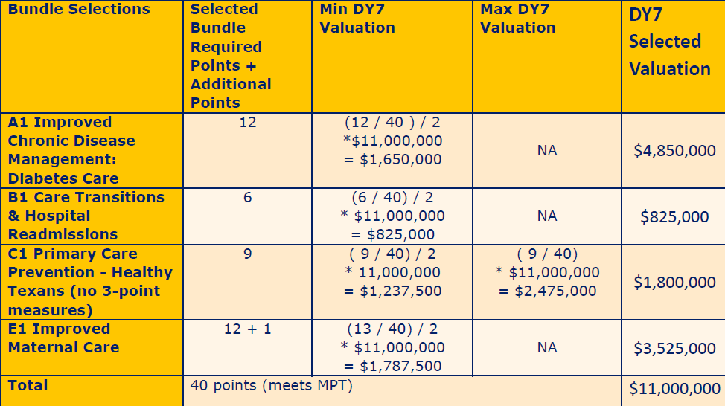
Bundle Valuation - EXAMPLE

Slide 18
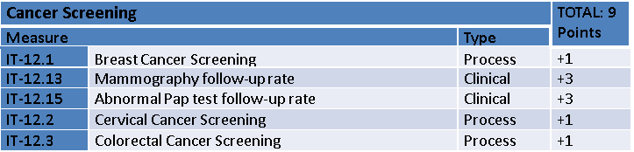
Metric Valuation EXAMPLE
$308,000
30.8%
$61,600
$61,600
$61,600
PREDETERMINED
$61,600
$61,600
$692,000
69.2%
$138,400
$138,400
PREDETERMINED
$138,400
$138,400
$138,400
Minimum Point Value for UMC : 12
TOTAL VALUATION for Category C: $1M

Slide 19
Metric Valuation EXAMPLE
$308,000
30.8%
$61,600
$61,600
$61,600
PREDETERMINED
$61,600
$61,600
$692,000
69.2%
$138,400
$138,400
PREDETERMINED
$138,400
$138,400
$138,400
Minimum Point Value for UMC : 12
TOTAL VALUATION for Category C: $1M

Slide 20
Active Patient Definition
PRIMARY CARE
Two visits in the 12-month measurement period
One visit in the 12-month measurement period and one visit in the 12 months prior to the measurement period
Assigned to a primary care physician in your system
SPECIALTY CARE
You will propose an active patient definition for each specialty
COMBINED CARE
H1: Integration of BH in a Primary and Specialty Care Setting
H1-146: Screening for Clinical Depression & Follow-Up Plan
System:The provider’s system definition includes primary care clinics and outpatient specialty care clinics
Setting:Primary care clinics and outpatient specialty care clinics appropriate for bundle, in this case Endocrinology and Orthopedic
Active Patient: In each measurement period, the provider would identify individuals that meet the active patient definition in each setting
Denominator Specifications:From those individuals, the denominator would be determined following measure specifications

Slide 21
What Are Your COMMENTS & SUGGESTIONS regarding this plan?
Go to your Browser or Cell Phone:
http://pollev.com/oscarperez394
OR
To: 22333
Text: OSCARPEREZ394

