Slide 1

DY7 and beyond
A new DSRIP structure ….

Slide 2
DY7-8 Proposal
Additional 21 months of funding
  Uncompensated Care (UC) pool
  DSRIP pool
  Managed Care provisions
Same funding levels
STILL AWAITING APPROVAL from CMS
New updated RHP Plan
HHSC Needs Feedback on proposed protocol
  https://www.surveymonkey.com/r/MMBZ6P7

Slide 3
DY7-8 Proposal
RHP Plan Update
  Updated Community Needs Assessment
  Stakeholder Engagement Event
  Population by Provider (PPP) Baselines
  Measure Bundle Selections
  Planned Core Activities
  Valuation Amounts
  Signed Certifications from Leadership

Slide 4

NEW DSRIP STRUCTURE

Slide 5
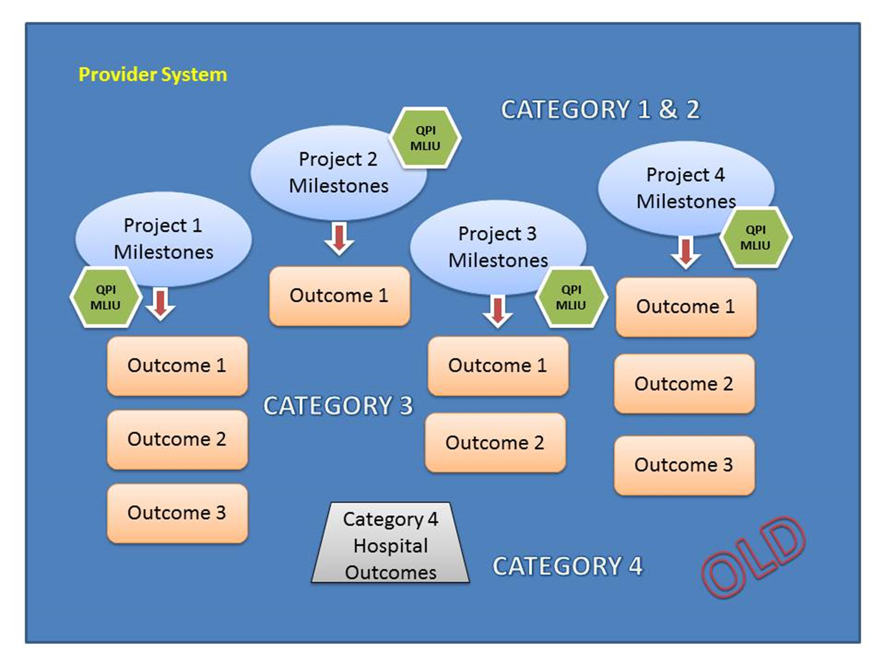
Project Level to System Level
CURRENT MODEL

Slide 6
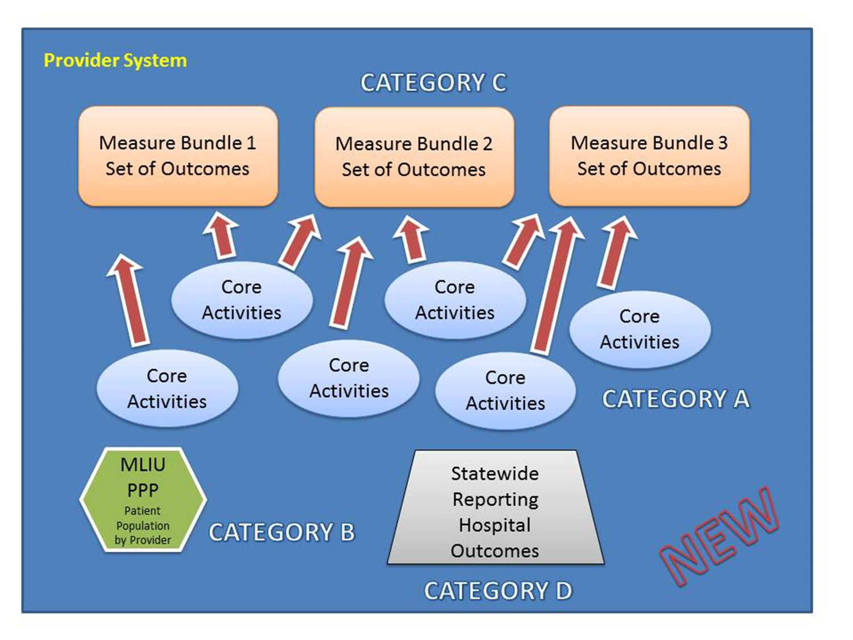
Project Level to System Level
NEW MODEL

Slide 7
NEW Categories
Category A – Core Activities
  Progress on core activities
  Alternative payment model arrangements
  Costs and savings
  Collaborative activities.
Category B - Medicaid and Low-income or Uninsured (MLIU) Patient Population by Provider (PPP)
Category C - Measure Bundles
  TBD
Category D - Statewide Reporting Measure Bundle
  similar to hospital Category 4 reporting

Slide 8
Funding Levels by Category
 | DY 7 | DY 8
Category A - Required reporting | 0% | 0%
Category B - MLIU PPP | 10% | 10%
Category C- Measure Bundles | 80% or 85% | 80% or 85%
Category D - Statewide Reporting Measure Bundle ** | 10% or 5% | 10% or 5%
**If private hospital participation minimums in the region are met, then Performing Providers may increase the Statewide Reporting Measure Bundle funding distribution to 10%.

Slide 9
Category A Requirements
Required to report in R2 (Oct) for eligibility on Categories B thru D
Core Activities should support achievement of selected measure bundles:
  Activities from DY2-6 Projects OR
  New Activities

Slide 10
Category A Requirements
Report to include:
  Core Activities
    Progress and updates on all activities
  Alternative Payment Methodology (APM)
    Progress toward OR implementation of APM arrangements with:
      Medicaid Managed Care Organizations (MCOs)
      Other Payors
  Costs and Savings
    Submit costs of core activities
    Forecasted/generated savings experienced from the activities
  Collaborative Activities
    Required to attend (each DY)
      Learning Collaborative (at least one)
      Stakeholder Forum
      Or other Stakeholder Meeting

Slide 11
Category B Requirements
Patient Population by Provider (PPP)
Report Total Individuals served (no more encounters):
  by the “system”
  Definition of “system” – TBD
Total MLIU Individuals served
  Medicaid and Low Income Uninsured definitions have not changed
NEW Baselines submitted in DY7
  Based on averages of DY5 and DY6
    Total Patients Served
    Total MLIU Patients Served
  May be used to determine valuation in DY9-DY10

Slide 12
Category B Requirements
Levels must be maintained in DY7 and DY8
Allowable Variation
  Determined by HHSC
    Based on Provider Size and Type of Provider
    Ratio of MLIU individuals served to the total individuals served
Not reported until the R1 (April) AFTER the DY
  EXAMPLE: DY7 MLIU PPP would be reported in DY8 R1 (April 2019)
If Levels are not maintained
  Partial Payment is AVAILABLE
    100%, 90%, 75%, 50% or 0% Achievements
ALL numbers reported must be auditable

Slide 13
Category C Requirements
MEASURE BUNDLES
  Improve Chronic Disease Management: Diabetes Care
  Improve Chronic Disease Management: Heart Disease
  Improve Maternal/Perinatal Care
  Primary Care & Prevention: Healthy Texans
  Primary Care & Prevention: Cancer Screening
  Hospital Safety
MEASURE BUNDLES
  Pediatric Primary Care
  Improve Access to Adult Dental Care
  Palliative Care
  Care Transitions
  Integration of Behavioral Health in a Primary Care Setting
  Behavioral Health and Appropriate Utilization
  Access to Specialty Care
  Chronic Non-Malignant Pain Management

Slide 14
Category C Requirements
Denominator Subsets DISCONTINUED:
  Facilty, Co-Morbid Condition, Age, Gender, and Race/Ethnicity
PFP will follow same achievement goals
  Remember New Baselines will be established in DY7
  QISMC (Quality Improvement System for Managed Care)
  IOS (Improvement on Self)
  5% Gap closure each DY
Must report all payor types
  Medicaid
  LIU
  All Others
Quartile partial payments still allowable

Slide 15
Point System
MINIMUM POINT VALUE
  Assigned to each TPI
  Defined by HHSC (state)
  If you do not meet the MINIMUM POINT VALUE
    Total Valuation will be reduced proportionally
  Measure Bundles
    Proportional to the MINIMUM POINT VALUE
      (Points of Measure Bundle / Minimum Point Value )
    Valuation of Measure Bundle
      (Points of Measure Bundle / Minimum Point Value ) * Total Cat C Valuation
PROPOSED

Slide 16
Point System
Factors for MINIMUM POINT VALUE
  DSRIP DY7 Valuation
  DSRIP DY6 Valuation
    Percentage of ALL participants DY6 Valuations
  Statewide Cap (as determined by the State)
  Size of the provider system (i.e. hospital)
  Role of the provider system in serving Medicaid & Uninsured Populations
    Texas Hospital Uncompensated Care Tool (TXHUC) for FFY 2016
      Outpatient charges
      Inpatient charges
    Disproportionate Share Hospital (DSH) and UC Pool
      Compared to ALL hospitals
PROPOSED

Slide 17
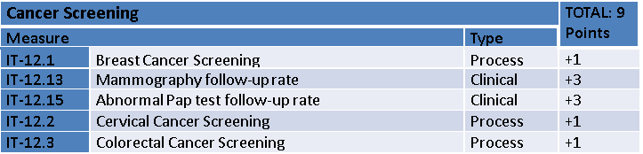
Category C Example
$308,000
30.8%
$61,600
$61,600
$61,600
PREDETERMINED
$61,600
$61,600
$692,000
69.2%
$138,400
$138,400
PREDETERMINED
$138,400
$138,400
$138,400
Minimum Point Value for UMC : 12
TOTAL VALUATION for Category C: $1M

Slide 18
Category D Requirements
Very Similar to the old Category 4 for Hospitals
  PPR
  PPC
  PPA
  HCAHPS
  Medication Management
  ED LOS

Slide 19
Timeline
February 2017
  Feedback on PFM
  Define “system”
  Determine Point Thresholds for bundles
  Requirements for LHDs
  Determine uses for remaining DSRIP funds ($25M per DY)
March 2017
  Submit PFM to CMS for approval
April 2017
  DY6 R1 Reporting due
May 2017
  Finalize definition of Measure bundles
June 2017
  Public comment on DY7-8 proposal (PFM)
July 2017
  Submit Measure Bundles to CMS for approval

Slide 20
Timeline
August 2017
  CMS Approval of protocols (PFM)
October 2017
  DY6 R2 Reporting Due
November 2017
  Updated RHP Plans due

Slide 21
DSRIP Opportunities for Payment

Slide 22
What Are Your COMMENTS & SUGGESTIONS regarding this plan?
Go to your Browser or Cell Phone:
http://pollev.com/oscarperez394
OR
To: 22333
Text: OSCARPEREZ394

Slide 23
Provider System
CATEGORY 1 & 2
QPI
MLIU
Project 2
Milestones
Project 4
Milestones
Project 1
Milestones
Project 3
Milestones
QPI
MLIU
QPI
MLIU
Outcome 1
QPI
MLIU
Outcome 1
Outcome 1
Outcome 1
Outcome 2
CATEGORY 3
Outcome 2
Outcome 2
Outcome 3
Outcome 3
Category 4 Hospital Outcomes
OLD
CATEGORY 4

Slide 24
Provider System
CATEGORY C
Measure Bundle 1
Set of Outcomes
Measure Bundle 2 Set of Outcomes
Measure Bundle 3 Set of Outcomes
Core
Activities
Core
Activities
Core
Activities
Core
Activities
Core
Activities
Core
Activities
CATEGORY A
MLIU PPP
Patient Population by Provider
CATEGORY B
Statewide Reporting
Hospital Outcomes
NEW
CATEGORY D

