Slide 1
Enhancing Health Department’s Preventive Health Services – “Stretch Activities”
Claudia Lozano, MPH, CHES
RHP 15 Meeting
September 28, 2016

Slide 2
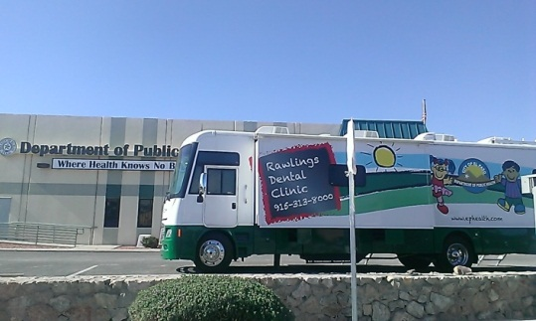
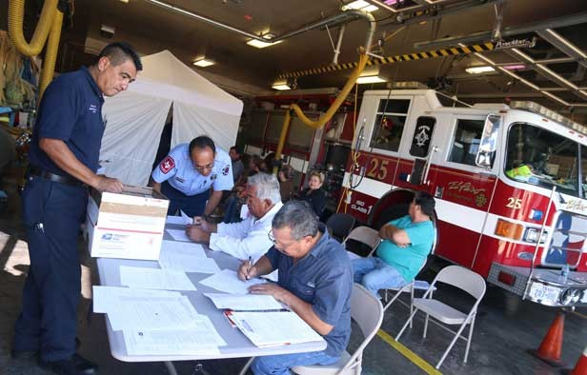
1115 Texas Healthcare Transformation Waiver
Border Public Health Interest Group
Community Health Atlas
Mobile Dental Clinic
Health Information Exchange
Neighborhood Fire Stations
Three Year Health Initiative

Slide 3
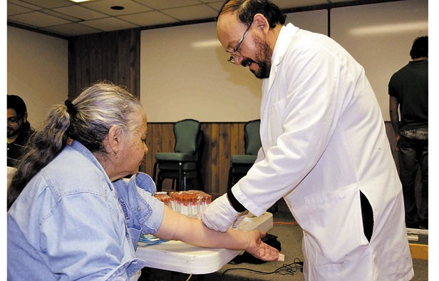
Preventive Health Services
The purpose of the 1115 Healthcare Transformation waiver, is to expand healthcare services and improve the health of uninsured and Medicaid populations in Texas.
Cancer Screenings
Immunizations
Blood Pressure and Glucose Check
Teen pregnancy prevention and treatment
STD testing and follow-up
Hepatitis C linkage to care
Referral to resources and additional services
Health Education and Group Sessions

Slide 4
Measures Description
Category 3 Outcome
Chlamydia 3 month follow-up
Teen Pregnancy Rate
Influenza and Pneumonia Vaccines
Cancer Screenings
Stretch Activity
HHSC requirement to supplement Pay for Reporting (P4R) metrics to demonstrate improvement of project
50% of payment allocation
SA3: Alternative Approaches to Program and Outcome Linkages

Slide 5


“Stretch Activities”
Media Campaign
Training and Conferences
Symposium to Prevent Teen Pregnancy
Maternal and Child Health Epidemiology Conference
Clinical and Health Education Personnel
Partnerships
Process Evaluation
Identified focus areas by zip code
Database and EMR upgrades

Slide 6
Community Benefits
Preventive Health Services | DY4 | DY5
Vaccines | 1336 | 2052
Cancer Screenings | 48 | 202
Chlamydia Treatments | 263 | 235
Hep C Follow-ups | 241 | 309
Teen Pregnancy Prevention Participants | 71 | 218
Fire station clinic participants | 1008 | 1160
Mobile Dental Exams | 320 | 252
Community outreach/Referral Services | 1954 | 2352
Total | 5851 | 6728

Slide 7
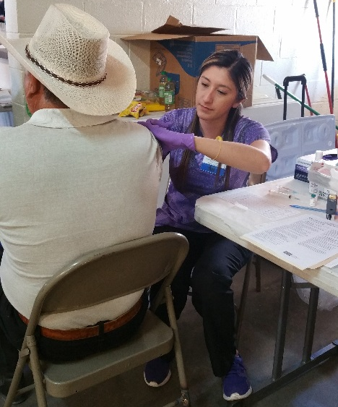
Improvements
Colonoscopy services
Transportation
Collaborative projects with RHP15
Onsite services
Research Publications
Grants

Slide 8
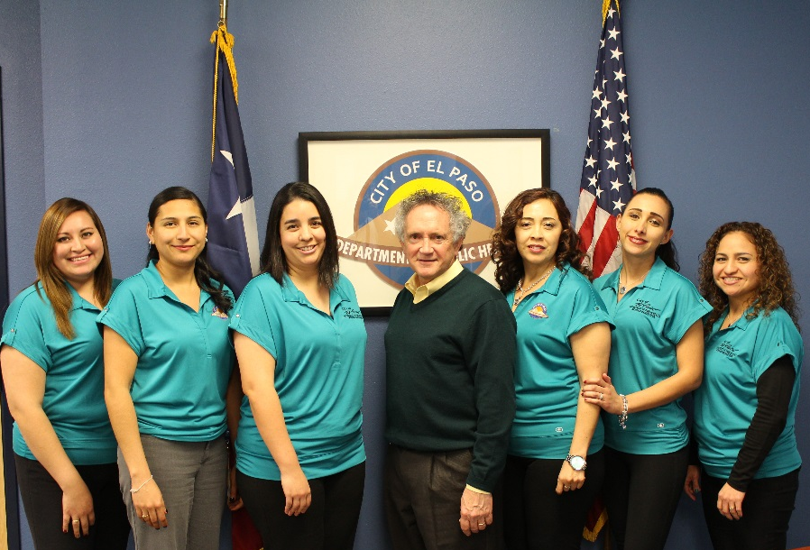
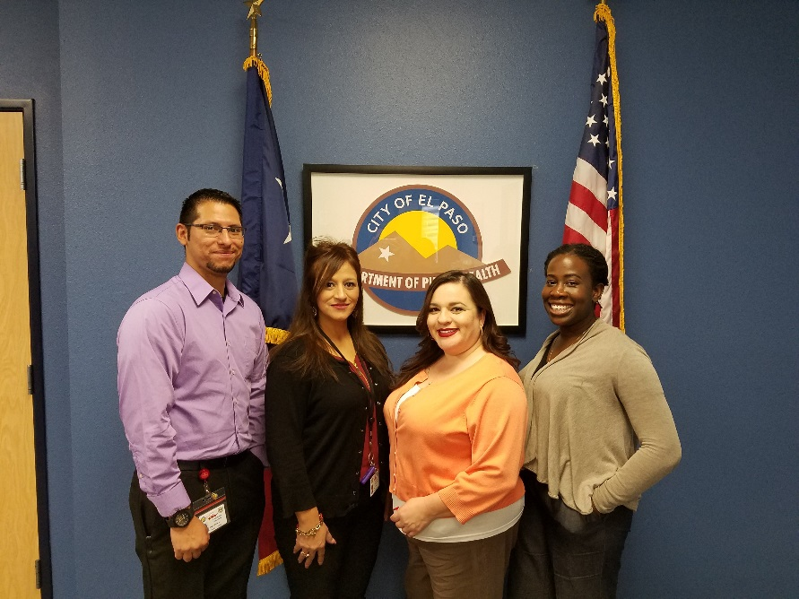
Questions
Thank You!

