Slide 1


Vaccinations for health
Deputy Chief Robert Arvizu
Wednesday March 25, 2015
RHP 15 Meeting

Slide 2
Purpose of Program
It started out as a way to combine the resources of two El Paso City Departments in order to provide essential services to our senior population. The Vaccinations for Health program is a cooperative endeavor between the City of El Paso Department of Public Health and the El Paso Fire Department. It officially began September 2014 with Fire paramedics administering flu shots, pneumonia vaccines, and basic health screenings to seniors 50 years of age and older who are on Medicaid or who are uninsured.

Slide 3
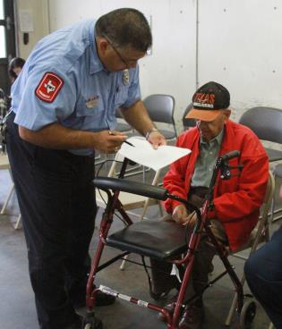
Pilot Program
The program kicked off Sept. 13, 2014 at Central Station, 201 S. Florence. Push cards, posters and flyers were distributed. Sun Metro placed display ads in their fleet. A series of Diario de El Paso ads ran from Sept. 9-13. A total of 49 patients were seen.

Slide 4
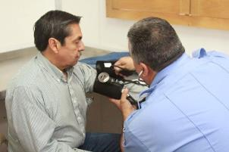
Pilot Program – Week 2
The pilot continued on Sept. 25, 2014 at Station 25, 10834 Ivanhoe. Posters were distributed. PIO did interviews on Noticias MVS, Univision and Telemundo. A series of Diario de El Paso ads ran from Sept. 24-25. A total of 54 patients were seen.

Slide 5
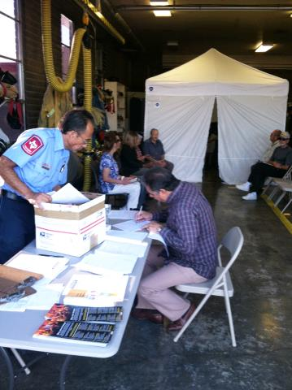
Program Launch
The program officially started Oct. 4 at Station 7, 3200 Pershing. No paid advertising was utilized; only a media blitz. PIO did interviews on Univision, NBC, Noticias MVS, and Fox. Posters and flyers were still distributed. A total of 43 patients were seen.

Slide 6
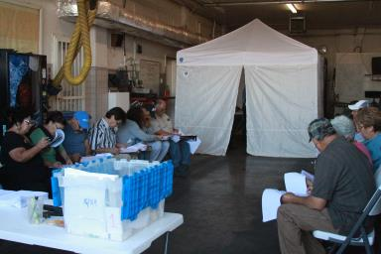
Program Peek
The program hit its high mark on Oct. 11 at Station 17, 8803 Alameda. No paid advertising was utilized; only posters, flyers and a KTSM interview by Chief Robert Arvizu and PIO. A total of 107 patients were seen!

Slide 7
Continued Results
Oct. 18 – Station 22, 6500 N. Mesa – 22 patients
Oct. 25 – Station 23, 5315 Threadgill – 44 patients
Nov. 1 – Station 18, 7901 San Jose – 60 patients
Nov. 8 – Station 6, 1850 Firehouse – 25 patients
Nov. 15 – Station 5, 400 Revere – 38 patients
Dec. 6 – Station 27, 6767 Ojo de Agua – 5 patients
Dec. 13 – Station 34, 6565 Angora Loop – 26 patients
Jan. 17 – Station 12, 3801 Fort. Blvd – 49 patients
Jan. 24 – Station 14, 6300 Delta – 33 patients
Jan. 31 – Station 26, 9418 North Loop – 26 patients
Feb. 21 – Station 2, 111 E. Robinson – 18 patients
March 21 – Station 3, 721 Rio Grande – 1 patient

Slide 8
Alternative Sites
On Jan. 24, a clinic was set up in Ft. Hancock to offer the same services to residents of that community. A total of 11 patients were seen there.
On Feb. 21, a clinic was set up at Mary Webb Park, 3401 East Missouri as part of the Black History Month Celebration. A total of 14 patients were seen.

Slide 9
Next Strategy
As the numbers have started to slow down, we will concentrate on setting up clinics at existing functions with high traffic of seniors. Some examples include:
Dia de los Niños – April 25 (lots of grandparents)
Purple Day Health Fair – May 2 (Elder Abuse Prevention Month)
Aging to Perfection Expo – May 22

Slide 10
Yearly Totals
Excluding the two pilot days, we have seen a total of 516 patients (619 including). We project we will hit the yearly goals as we start up the Station clinics again September 2015 in preparation for the next flu season.

