Slide 1

City of El Paso Department of Public Health Region 15 Regional Health Partnership 1115 Healthcare Transformation Waiver
RHP 15 Meeting
3/25/3015
Nick Emerick, MA

Slide 2
REAL Data
Race, Ethnicity, and Language collected with other demographic data
Collection interests of all stakeholders
Collection instrument standardization
Collected with surveys during the intake process
Standardization allows for combining across four projects

Slide 3
Background
Data collection used as a screening process for services
Participating Institutions
UTEP
UTH
Texas Tech
Fire Department
DPH Preventative Medicine Clinic

Slide 4
Border Public Health Interest Group
A collaborative with local universities
Flu, pneumonia, and HPV vaccines
Cancer screenings
Environmental assessment
Health Classes
Cancer screenings currently in contract reviews
Developed Voucher System
Working with housing authority

Slide 5

Expansion of Oral Health Services
Offers dental check-ups for persons 21 and younger.
Financial assistance available for uninsured and low-income persons.
Mobile unit deploys to local Head Start locations
Has served 65% Medicaid and 35% uninsured

Slide 6
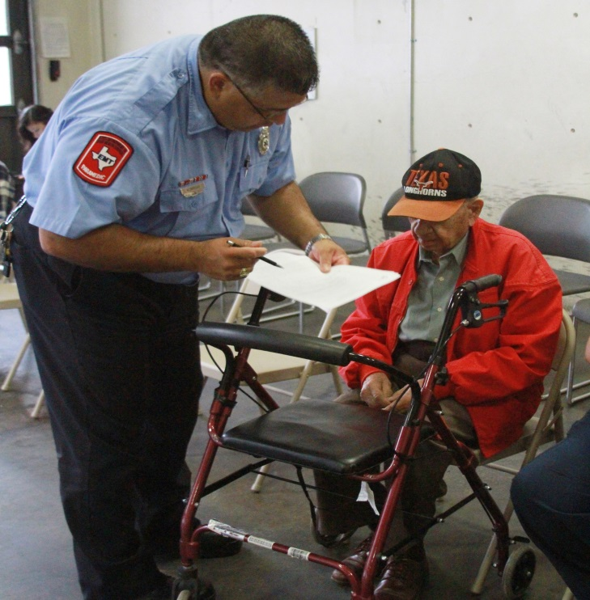
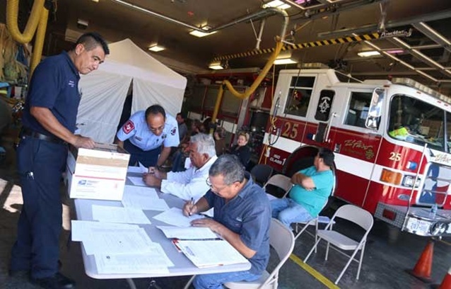
Neighborhood Fire Stations

Slide 7

El Paso Community Health Atlas
Web-based application to map health of community
Identify locations where health services are needed
STD testing
Flu and pneumonia vaccines
HPV vaccines
Cancer screenings

Slide 8
Challenges and Opportunities
Health Information Exchange
Hospital Agreements
Collaborating with local hospitals for baseline data
Low Voucher return rates
Possibly undercounted
Most common issues with schedule or transportation
Can be mitigated by on site services delivery
Ongoing negotiations for cancer screening providers

