Slide 1


Neighborhood Fire Stations for Health screening and health promotion
El Paso Fire Department
March 2016

Slide 2
Introduction
Wellness of our seniors is tied to preventative care.
The populations we most commonly serve:
Hispanics with low household education and higher levels of poverty.
Mostly Medicaid or uninsured.

Slide 3
Program Evolution
DY1 – Identified need and applied for funding.
DY2 – Identified health strategies, execution plans and partnerships.
DY3 – Trained personnel, implemented protocols, purchased equipment, developed marketing and launched pilot program.
DY4 – Implemented the program and analyzed service delivery and marketing efforts.
DY5 – Continued program by implemented improvements to enhance service delivery and outreach.

Slide 4
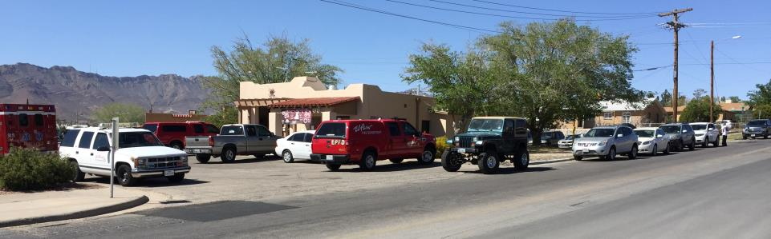
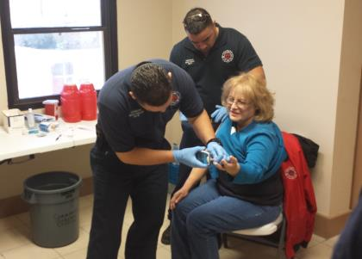
Statistics DY3, DY4, DY5

Slide 5
DY3

Slide 6
DY4

Slide 7
DY5

Slide 8
Promotion of Project
Summary:
Initially we advertised the project with half page ads in Diario de El Paso to educate the public about the initiative.
However, we learned that word of mouth works best with the population served.

Slide 9
DY4

Slide 10
DY5

Slide 11
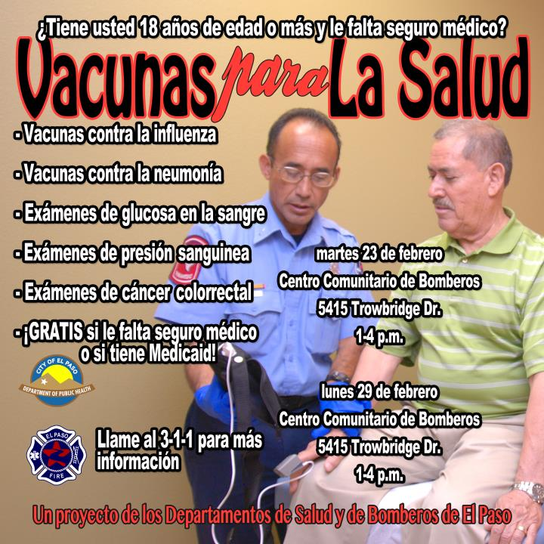

Slide 12
Accomplishments
Program outreach and service delivery are increasing our early numbers.

Slide 13
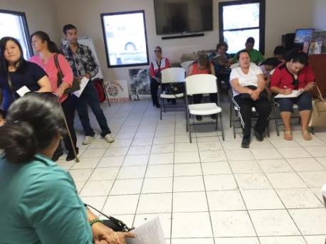
Accomplishments
Program outreach and service delivery are increasing our numbers.
Paperwork processing has been streamlined. Demographic sheet condensed. Waiting time has been reduced.
Centralized location at EPFD’s Safety, Health Outreach Center (SHOC) at corner of Chelsea and Trowbridge.

Slide 14
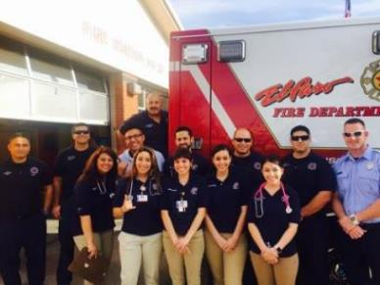
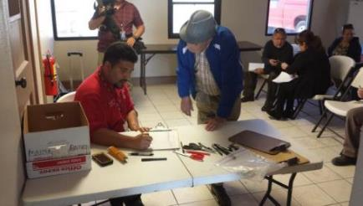
Improvements
Recruitment of volunteers to assist elderly with paperwork and/or health assessments.
PIO attending all clinics for paperwork quality control.
More targeted marketing.
Continued collaboration with BHIG partners.

Slide 15
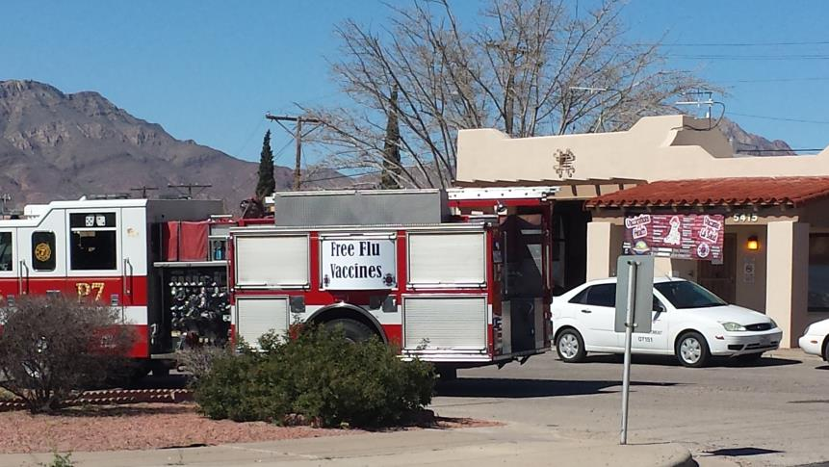
The rigs are excellent marketing!

Slide 16
Closing out DY5
In DY4, we had clinics at 50% of the fire stations.
In DY5, six more fire stations remain to satisfy the process matrix for service delivery at the other 50% of fire stations.
Currently at 820 of 1,000 NEW patients (six months).
Meet performance requirements for DSRIP
- increase in number of influenza and pneumococcal
vaccines
- increase in of ColoCare returns

Slide 17
Questions or comments?

