Slide 1


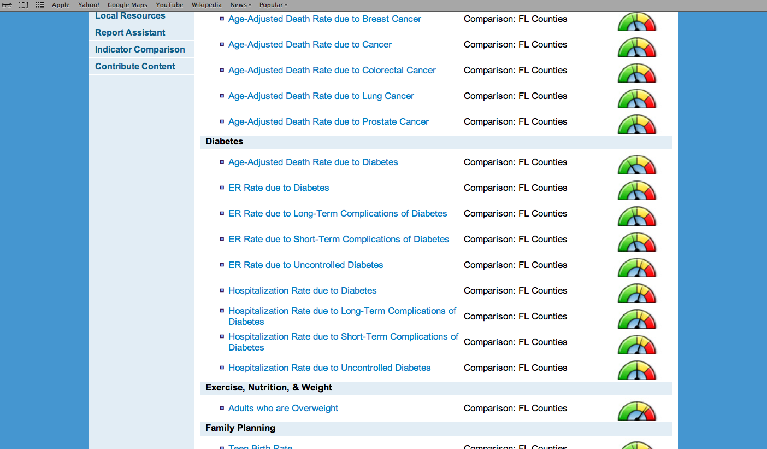
GIS Capabilities
City of El Paso Department of Public Health
Region 15 Regional Health Partnership
1115 Healthcare Transformation Waiver
Expansion of Oral Health Services
Bruce Parsons, Assistant Health Director
Region 15 RHP Meeting
March 28, 2014
1:00pm

Slide 2
GIS Capabilities
Description of Project
Synopsis:
The Expansion of Oral Health Services Project will extend preventive and restorative dental services to low income children outside of the current catchment area for the health department’s fixed site dental clinic in central El Paso. Services will be provided through a mobile dental clinic which will be deployed to select schools, Head Start sites, and WIC clinics. Clinical services will be supplemented by research opportunities.
Participating Institutions:
-City of El Paso Department of Public Health -Texas Tech University Paul L. Foster School of Medicine Department of Biomedical Sciences

Slide 3
GIS Capabilities
Major Milestones DY2/DY3:
Designed/purchased two operatory mobile dental including interview/research enrollment area
Catalog current research activity to identify common thematic elements and opportunities for collaboration for REAL data collection and analysis
Developed research proposal for analysis of saliva samples to identify constituents that exacerbate dental disease in Mexican-American children

Slide 4
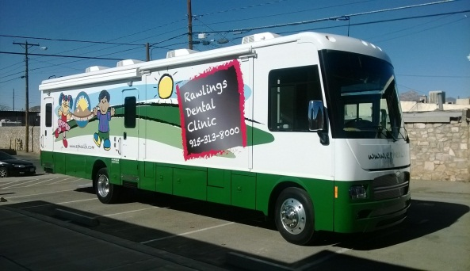
GIS Capabilities
Innovation
Infection
Detection
Pediatric Dental Services
Salivary
Chemistry
Dental Services
Environmental
Health
Metabolic
Biomarkers
Child Development
Pregnancy
Nutritional Evaluations
Community Health Policy
Community
Health
Policy
Nutritional Evaluations

Slide 5
GIS Capabilities
Innovation
FAMILY as a research/intervention cohort…
Provide valuable clinical/research services to select family members (mother/child dyad)

Slide 6
GIS Capabilities
Progress
Milestones status:
Research project identified for core dental services for reduction in dental caries/tooth loss
-Presenting health status, e.g., BMI, dietary data
-Bacterial profile (DNA sequencing multiplex test)
-Salivary profile, e.g., inflammatory cytokines, glucose
-Environmental toxins, i.e., lead, cadmium
-Geopositional profile (multi-site deployment of van)

Slide 7
GIS Capabilities
Additional research opportunities identified through Pass 3 process
-Hepatitis C and Diabetes
-Cardiorespiratory conditions (environmental influences)
-Social determinants of health and promotores as navigators
-Preventive screening for cancer using saliva
-Teen pregnancy prevention/treatment

Slide 8
Border Public Health Research/Community Health Atlas: An Integrated Model for Health Improvement
DPH: HepC
UTEP: Cardio Respiratory
BPHIG
Dental
ATLAS
EP Atlas CMS/HHS Dartmouth Atlas
UTH: Social Determinants
GPS
Fire Stations
School of Medicine: Cancer
DPH Fluid and Tissue Bank
Community: Teen Pregnancy
Policy/Programs
Improved Health
Status?
New research opportunities

Slide 9
GIS Capabilities
Questions?

