Slide 1

1.5 Increasing Access to Surgical Services
Rene Vallejo
Region 15 RHP Meeting
El Paso First Healthplan, 1145 Westmoreland Drive
August 28, 2014
1:00pm

Slide 2

Benefits to the Community
Each new surgical provider, when established, will provide services to a minimum of 250 unique patients each year. Benefit to Medicaid / Indigent Patients: Given that 60% of our enterprise ambulatory encounters are to patients with Medicaid or no insurance, this project will be a direct benefit to that population

Slide 3
Progress
Milestones:
Hire Provider 100%
Increase clinic volume 100%
Staffing Plan for e-Referral 100%
Train Staff on e-Referral 100%
Demonstrate e-Referral 100%
2 RHP Seminars 50%
CAT-3 Baseline Patient Satisfaction 100%
Risk Areas:
  Hiring Providers
  e-Referral out to community
Anticipated outcomes:
  Meet all Milestones

Slide 4
Data - Volume
DY2 | OCT | NOV | DEC | JAN | FEB | MAR | APR | MAY | JUN | JUL | AUG | SEP
UNINSURED | 120 | 70 | 57 | 75 | 71 | 71 | 79 | 75 | 45 | 72 | 54 | 69 | 858
MEDICAID | 35 | 9 | 21 | 13 | 21 | 16 | 14 | 15 | 12 | 9 | 10 | 9 | 184
ALL OTHERS | 205 | 123 | 87 | 82 | 127 | 98 | 103 | 82 | 58 | 101 | 40 | 92 | 1198
Total Patients | 360 | 202 | 165 | 170 | 219 | 185 | 196 | 172 | 115 | 182 | 104 | 170 | 2240
% Uninsured | 33% | 35% | 35% | 44% | 32% | 38% | 40% | 44% | 39% | 40% | 52% | 41% | 38%
% Medicaid | 10% | 4% | 13% | 8% | 10% | 9% | 7% | 9% | 10% | 5% | 10% | 5% | 8%
DY3
UNINSURED | 181 | 106 | 76 | 74 | 108 | 93 | 58 | 88 | 93 |  |  |  | 877
MEDICAID | 23 | 14 | 17 | 17 | 17 | 18 | 14 | 14 | 10 |  |  |  | 144
ALL OTHERS | 150 | 106 | 68 | 74 | 106 | 104 | 132 | 76 | 87 |  |  |  | 903
Total Patients | 354 | 226 | 161 | 165 | 231 | 215 | 204 | 178 | 190 |  |  |  | 1924
% Uninsured | 51% | 47% | 47% | 45% | 47% | 43% | 28% | 49% | 49% |  |  |  | 46%
% Medicaid | 6% | 6% | 11% | 10% | 7% | 8% | 7% | 8% | 5% |  |  |  | 7%

Slide 5
Innovations
Improvements to processes:
  Educated team on CQI/Rapid Cycle Improvement
  Documented existing process
    Foundation for improvement
    Patient workflow for different specialties
    Schedule Matrix
    Intake process
    Developed new referral process for VA patients
    H&P /Funding Process
    Billing Denial process/AR review/ provider review
    eReferral (RMS) process improvements

Slide 6
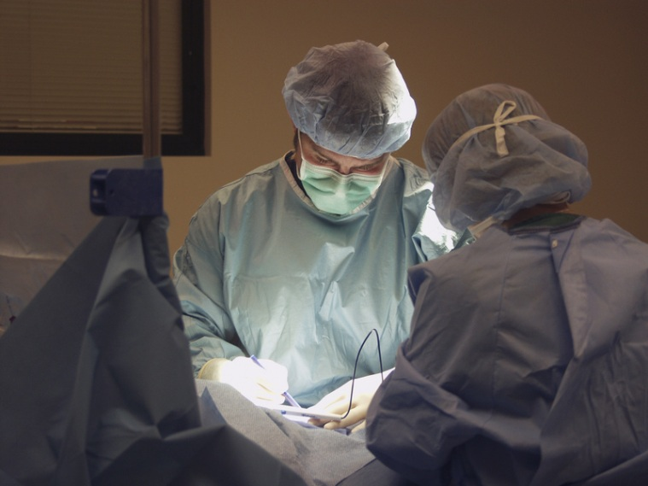
Need Ideas from the Crowd on Recruiting
The summary of this search is that most of the candidates are declining due to location.@55%
Candidates said that the salary is competitive, but in line with other offers they were weighing.

Slide 7

Questions?
Comments?

