Slide 1

DSRIP CATEGORY 3 - Update
Oscar Perez
1115 Waiver - DSRIP Project Manager
Region 15
February 26 2014

Slide 2
New CAT-3 FRAMEWORK
More choices in Measures
Help support Renewal of Waiver
Documents-Tools
Texas Cat-3 Menu - spreadsheet
Selection Tool – spreadsheet
Alternate Performance Measures - spreadsheet
Compendium – benchmarks

Slide 3
NEW Cat-3 framework
Outcome Measures – “QUALITY IMPROVEMENTS”
SA (1) or NSA (3)
P4P or P4R
PA – Prior Authorization
“grandfathering”

Slide 4
New cat-3 framework
Benchmarked Targets added (Methodologies)
QISMC – Quality Improvement System for Managed Care
HPL – High Performance Level
MPL – Minimum Performance Level
Gap – difference between baseline and HPL or MPL
IOS– Improvement Over Self

Slide 5
New CAT-3 FRAMEWORK
Care Setting - suggested
Ambulatory
Inpatient
Both
Emergency Department
DY3-DY4-DY5

Slide 6
P4p - p4r
ALL outcomes have been labeled
P4P Preferred
If P4R is selected
PA is necessary
Pick Alternate Performance Activity
Population-Focused Priority Measure OR
Stretch Activity
Specific Measures for:
Hospitals
Community Mental Health Centers
Academic Health Science Centers

Slide 7
Od-6 od-10
Patient Satisfaction Quality of Life
P4P
SA
STRONGLY recommend ANOTHER measure

Slide 8
Custom denominators
CMS has allowed for tailored denominators ** ONLY P4P measures
If project goal is to target specialized populations
NOT to be used on Population Focused Priority Measures (P4R)
These measures are intended to reflect improvement across ALL provider’s projects

Slide 9
CUSTOM DENOMINATORS
Use tool to modify
“Forecast” feature
Will calculate percentiles
Choose ONE Category
Payer Source (Medicaid-Indigent)
Target Condition
Age
Race/ethnicity
Gender
Facility(ies) where services are delivered
Others can be added in Description field on Tool

Slide 10
Valuation changes
Totals the Cat 3 Funds available per year (DY3 –DY4 – DY5)
Default distribution
100 / Number of Cat 1-2 Projects (% per project)
You can decide new distribution per project (%)
NO project can be below MINIMUM
MINIMUM = 50% of Default Distribution
Dollar amount per Cat-3 Measure:
Calculated based on total Cat-3 Measures per Project (EQUALLY divided)

Slide 11
CAT-3 reporting and payments
Framework
DY3 -- Baseline
DY4 – Increase Outcome
DY5 – Increase Outcome
DATA certification
Head Quality Officer or Executive Level Officer
ALL baselines and subsequent submissions of data

Slide 12
CAT-3 reporting and payments
PARTIAL payment rules apply
T o only achievements (NOT reporting only)
Full achievement – 100% payment
At least 75% achievement – 75% payment
At least 50% achievement – 50% payment
At least 25% achievement – 25% payment
Less than 25% achievement – 0% payment

Slide 13
CAT-3 reporting and payments DY3
DY2
ALL carried-forward Cat-3’s
MUST demonstrate achievement for full DY2 payment
Submit Status Report of carried-forward DY2 Cat-3 OR
Submit Achievement (documentation) of carried-forward DY2 Cat-3
DY3 - Baseline Data
April Reporting
50% payment for reporting STATUS of new Cat-3’s
Oct Reporting
Remaining 50% payment for validated BASELINES of new Cat-3’s

Slide 14
CAT-3 REPORTING and payments DY4
DY4 –Improvement Reporting
5% over baseline IOS
10% of HPL gap QISMC
HPL - 90th percentile Benchmark (State or National) OR
Reach MPL QISMC
MPL - 10th or 25th percentile Benchmark (State or National)

Slide 15
CAT-3 REPORTING and payments DY4
DY4 Payments
ALL P4P Measures
50% Funding – REPORTING
50% Funding – ACHIEVING
ALL P4R Measures – **MUST have PA
100% funding -- REPORTING

Slide 16
CAT-3 REPORTING and payments DY5
DY5 - Improvement
10% over baseline IOS
20% of gap QISMC
HPL 90th percentile Benchmark (State or National) OR
10% of difference MPL and HPL QISMC
MPL 10th or 25th percentile Benchmark (State or National)

Slide 17
CAT-3 REPORTING and payments dy5
DY5 Payments
ALL P4P Measures
100% Funding – ACHIEVING
ALL P4R Measures – **MUST have PA
50% funding – REPORTING
50% funding – ACHIEVING **
Population Focused Priority Measure OR
Stretch Activity

Slide 18
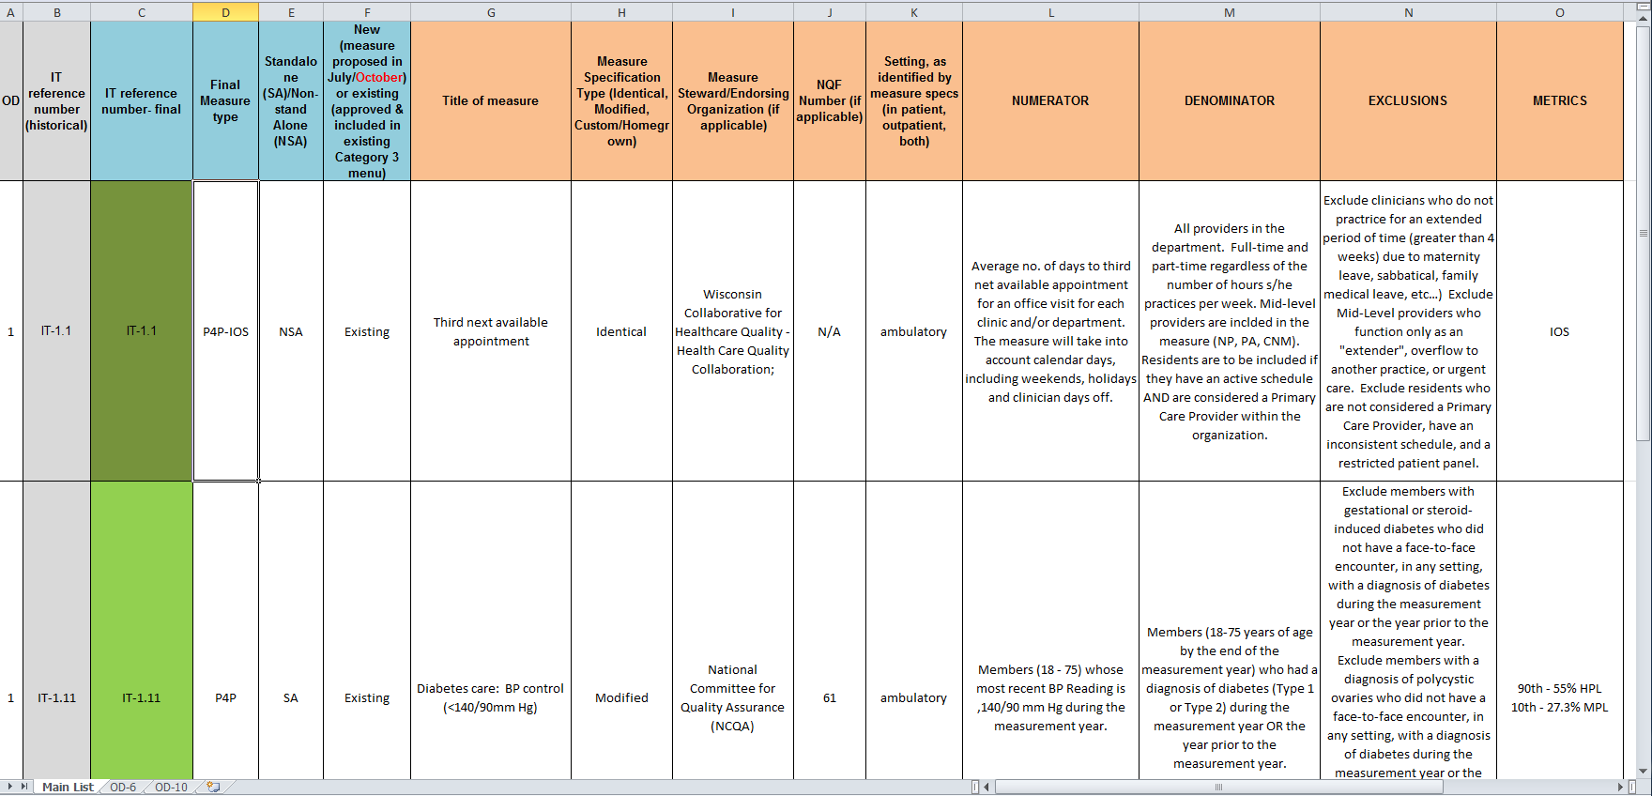
Example - Texas Cat-3 list

Slide 19
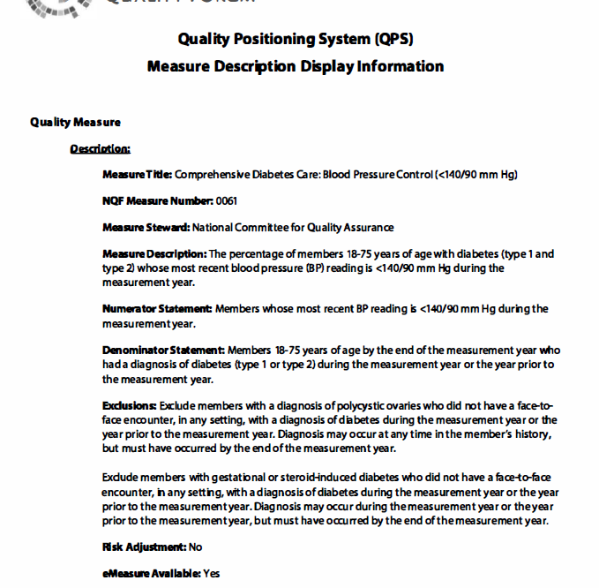
EXAMPLE

Slide 20
EXAMPLE
CURRENT | DESCRIPTION | PROJECT(s) | TARGET POPULATION | TYPE |  | PROPOSED (NEW) | METRICS | NOTES
IT-11.3 | Custom - Diabetic Eye Exams | 1.1 Ophthalmology (3.3) | Hispanic Diabetic Patients | P4P | NSA | IT-1.12 | 90th - 69.7% HPL 10th - 36.3% MPL | HEDIS 2011 - Medicaid
IT-11.4 | Custom - Quality of Life - Patient Satisfaction | 1.1 Ophthalmology (3.2) | Hispanic Patients | P4P-IOS | SA | IT-6.2b | tool specific | IOS
IT-11.6 | Custom - Time to 3rd Appointment | 1.1 Ophthalmology (3.1) | Hispanic Diabetic Patients | P4P-IOS | NSA | IT-1.1 | National Performance Goal | NOT QISMC Fit
IT-1.11 | Diabetes Care- BP Control < 140/90 | 1.2 Chronic Disease Mgt Registry (3.4) | Diabetic Patients | P4P | SA | IT-1.11 | 90th - 55% HPL 10th - 27.3% MPL | HEDIS 2011 - Medicaid
IT-11.1 | Custom - Seizure Re-occurrence | 1.3 Neurology (3.5) | Hispanic Epileptic Patients | P4P-IOS | NSA | IT-1.26 | National Mean | NOT QISMC Fit
IT-10.1 | SF-36 Quality of Life Survey | 1.4 Breast Care Services (3.6) | Patients enrolled in Survivor's Program | P4P-IOS | SA | IT-10.1b.iv | tool specific | IOS
IT-6.1 | VSQ-9 Patient Satisfaction Survey | 1.5 Surgery (3.7) | All Surgery Patients | P4P-IOS | SA | IT-6.2b | tool specific | IOS
IT-11.1 | Custom - TDap Booster | 1.6 Pediatric Well Child Exams (3.8) | Pediatric Patients in Acute Care Setting (Hispanic) | P4P | NSA | IT-8.22, 8.23, 8.25 | 90th - 77.3% HPL 10th - 43.8% MPL 90th - 83% HPL 10th - 61.1% MPL 90th - 64.7% HPL 10th - 35.5% MPL | First 15 months 3,4,5,6 Years Adolescents
IT-14.4 | Physicians currently practice in HPSA's or MUA's | 1.7 MIGS Fellowship (3.9) | Fellows enrolled in program | P4P-IOS | NSA | IT-14.4 | none presently | CMS Proposed
IT-14.7 | Physicians plan to practise in HPSA or MUA | 1.7 MIGS Fellowship (3.10); 1.8 Child Psych Fellowship (3.16) | Fellows enrolled in program(s) | P4P-IOS-PA | NSA | IT-14.7 | none presently | CMS Proposed
IT-14.8 | Physicians plan to serve Medicaid populations | 1.7 MIGS Fellowship (3.11); 1.8 Child Psych Fellowship (3.17) | Fellows enrolled in program(s) | P4P-IOS-PA | NSA | IT-14.8 | none presently | CMS Proposed
IT-14.6 | Physicians spent 5 years living in a HPSA, MUA | 1.8 Child Psych Fellowship (3.15) | Fellows enrolled in program | P4P-IOS-PA | NSA | IT-14.6 | none presently | CMS Proposed
IT-1.12 | Diabetes Care - Retinal Eye Exams Rcvd | 2.1 PCMH (3.12) | Diabetic Patients | P4P | NSA | IT-1.12 | 90th - 69.7% HPL 10th - 36.3% MPL | HEDIS 2011 - Medicaid
IT-1.13 | Diabetes Care - Foot Exam Rcvd | 2.1 PCMH (3.13) | Diabetic Patients | P4P | NSA | IT-1.13 | 90th - 81.3% HPL Mean - 64.6% | NHQR 2013
IT-1.14 | Diabetes Care - Nephropathy Exam Rcvd | 2.1 PCMH (3.14) | Diabetic Patients | P4P | NSA | IT-1.14 | 90th - 86.9% HPL 10th - 68.4% MPL | HEDIS 2011 - Medicaid

Slide 21
EXAMPLE
Baseline shows that we are at 35% compliant in BP control
HPL Benchmark is 55%
Gap is 20%
10% of 20% is 2%
DY4 goal would be to reach 37% compliant
We only reach 36% (1%/2% goal = 50% partial payment)
DY5 goal would be to reach 39% compliant
We only reach 37% ( we can get remaining 50% DY4 money – but no DY5 money)

Slide 22
timelines
Submit new-revised selections – March 10, 2014
Send to DeLoitte
Copy to Anchor
HHSC Feedback – April 1, 2014

Slide 23
issues
Change of Cat-3 Measures after the March submission?
Risk-Adjusted methodologies?
Can we completely change denominators eventhough our original narratives specify sub-groups?
IT-3.9 and IT-3.95 are the ONLY appropriate Smoking Cessation measures but now they have PA and Risk-Adjustments tacked on.
Time-to-3rd Apt (IT-1.1) NQMC description has Residents as an exclusion. Can we get an exception to this exclusion.
Will IT-14.6, 14.7, 14.8 (HPSA-MUA Questions of Fellows) be grandfathered if they were approved already by CMS?
IT-14.6, 14.7, 14.8 (HPSA-MUA) are dealing with small fellow-populations. Any small change will make a huge difference in reporting (since questions are YES-NO)
What is Specific Criteria for PA (Prior Authorization)?
Questions on monies used on projects.

