Slide 1


RHP 15 Collaboration
&

Slide 2
Overall Executive Summary:
Rescue Mission Project
UMC has contracted with Tender Care Home Health to develop and implement an evidence-based nursing program in order to provide primary and preventive healthcare to clients of the Rescue Mission of El Paso.

Slide 3

Rescue Mission
This is a population that generally encounters difficulty accessing healthcare, preventive services, and especially coordination of care.
This program also delivers education and support to empower them to gain control of their lives through disease management, medication compliance, appropriate diet and nutrition, and lifestyle changes.

Slide 4

October 2015 Quick Facts
January Year to date
Meals Served: 8,782 162,707
Clothing Issued: 4,505 70,343
Shelter Care: Men: 2,635 42,099
Women: 568 2.205
Children: 7 117
Quick Facts. (2015). Retrieved May 25, 2016, from http://www.rmelp.org/quick-facts.html

Slide 5
Sara Tapia RN

Slide 6


Slide 7

Salvation Army
This project will implement innovative evidence-based strategies in disease prevention areas.
The project aims to improve the health of the local homeless population, increase health awareness and knowledge, reduce the use of area emergency rooms, and implement the principles of preventative healthcare to the homeless population.
The project will reduce the number of patients who are admitted to the hospital as a result of difficulty managing chronic health conditions such as diabetes, obesity, and hypertension; the project will also reduce the use of emergency room visits by residents of the Salvation Army shelter by successfully managing their care on-site.

Slide 8
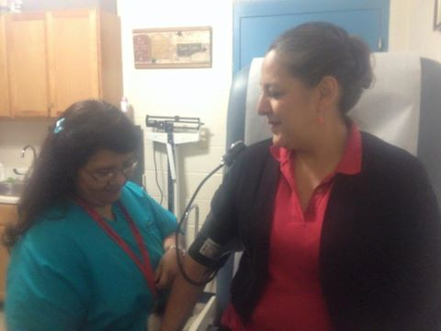
Dora Luz Tapia RN

Slide 9
Project’s Overview: Challenges
The lack of Medical Director and clinic protocols to be able to treat clients initially a huge challenge.
Dental issues, continue to be an area of concern for the clients of the Rescue Mission.
Government issued identification is required for all clients that need to be seen by UMC clinics for registration. Some clients do not have proper identification and opt to go to the emergency department as an immediate alternative.
Rescue Mission clients that work from 8:00am to 5:00pm, have limited access to shelter nurse due to hours operation.

Slide 10
Project Development Updates:
Jointly UMC and Tender Care Home Health and the Shelter Facilities have delivered education and support to empower this client population to gain control of their healthcare through disease management, medication compliance, and lifestyle changes
Tender Care will provide nursing and support services for the Rescue Mission’s and Salvation Army client’s in order to offer them a more appropriate alternative to using the UMC or other hospital ERs for their primary care or for other non-emergent care needs.
Immunization clinics have been established to immunize for the flu.
The clinics have expanded the network of resources for the clients of the Rescue Mission and Salvation Army.
Initial identification of potential health concerns, leading to referral, diagnosis, early intervention, and follow up education.
Shelter nurse participates in inter-disciplinary meetings pertaining to all clients of the Rescue Mission and their bio-psychosocial needs.

Slide 11


Reduction in EMS Calls
Rescue Mission
1949 W. Paisano | 2012-2013 | 2013-2014 | 2014-2015
December | 12 | 7 | 6
January | 13 | 10 | 12
February | 8 | 4 | 7
March | 6 | 9 | 4
Totals | 39 | 30 | 29
Salvation Army
4300 E. Paisano | 2012-2013 | 2013-2014 | 2014-2015
December | 7 | 5 | 4
January | 3 | 2 | 6
February | 3 | 0 | 2
March | 9 | 5 | 5
Totals | 22 | 12 | 13

Slide 12
Encounter Goals DY4

Slide 13
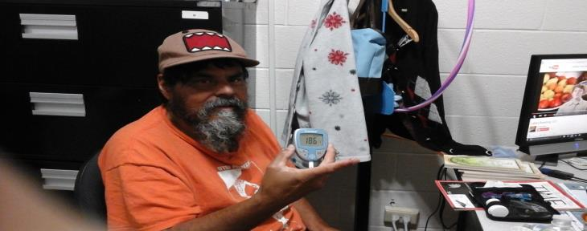
Project’s Overview: Lessons learned
We have been able to reduce emergency room visits, by educating the clients on the differences between emergency room issues versus a clinic issue.
Client’s health literacy has increased, and has empowered them to better self-manage their overall health.

Slide 14

Thank you
Questions?

