Slide 1
Ultrasound Guided Peripheral IV Insertion in the Emergency Department
Matthew Watford BSN, RN, EMT-B

Slide 2
Problem
Patients presenting to the Emergency Department with vascular anatomy not conducive to peripheral cannulation utilizing standard technique are subjected to numerous attempts at gaining access by any number of providers as deemed necessary by fellow ED staff.
There is no policy or protocol in place nor training available to support the use of Ultrasound to assist in cannulation of veins by nurses at UMC.

Slide 3
Current state of practice
Annual Data
Census: ~65,000 patients annually
% (#) peripheral IV starts:
Central Lines placed:
Central Lines placed for lack of peripheral access:
CLABSI Rate:

Slide 4
Intervention
Create a Policy/Procedure to protect Patients, Nurses, and the Hospital
Create a Nurse driven training program (2 hour)
Collect data, Analyze effect and Publish findings.
Focus on the Nurse

Slide 5
Benefits
Decreasing patient throughput time and delays in diagnosis and treatment due to less time spent obtaining venous access.
Risk/Cost reduction by avoiding critical care time and use of expensive equipment for central catheter insertion, at the same time eliminating exposure to iatrogenic complications such as pneumothorax and bloodstream infection, which increase mortality, hospital length of stay, and healthcare costs.
Decreasing complications of traditional insertion that include pain, arterial puncture, nerve damage, and paresthesias.
Increased EM physician satisfaction due to sustained productivity because of less interruptions to work flow to complete a routine procedure normally accomplished by nurse.
Increased emergency nurse autonomy.
Increased patient comfort and satisfaction.

Slide 6
Champions and Certification Criteria
Champions
Volunteer based.
Minimum 4 RN’s per team (12 RN’s total).
RN’s to assist future cohorts.
Certification Criteria
Completion of 2 hour training and/or competency demonstration.
3 supervised USG-PIV cannulations

Slide 7
The Training Program
2 hour training session.
3 supervised ultrasound guided cannulations with competency demonstration.
“Training and determination of competency for the use of ultrasound in procedural guidance will be defined by the practitioner’s respective specialty but should include basic didactic training in principles and practice of ultrasound, instruction in the techniques of ultrasound guidance for vascular access, and proctored assessment of competency in a simulated or actual patient care setting.” –AIUM clinical Practice Guidelines for USGPIV.

Slide 8
Course Outline
Lecture (30 minutes)
Overview
20 minute video
UMC specific considerations
Practical Skill Session (90 Minutes)
Patient positioning
Ultrasound basics
Vessel identification under ultrasound
Needle tip piloting under ultrasound
Advanced topics (probe orientation, gain)
2 hour training session of ED techs produced USG-PIV Success rates of 81%
(Bauman, M. et al, The Am J of Emer. Med.)

Slide 9
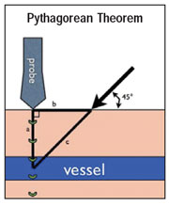
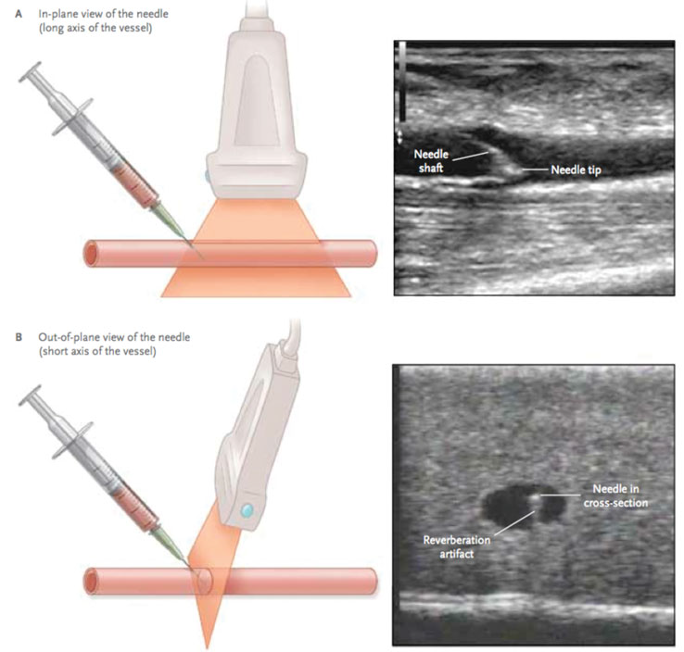
Catheter Length Matters!
1.2” catheters: 45%b failure rate at 24hrs
1.88” or greater: 14% failure rate at 24 hrs
(Elia, F. et al, Am J Emer Med 2013, 100 pts)

Slide 10
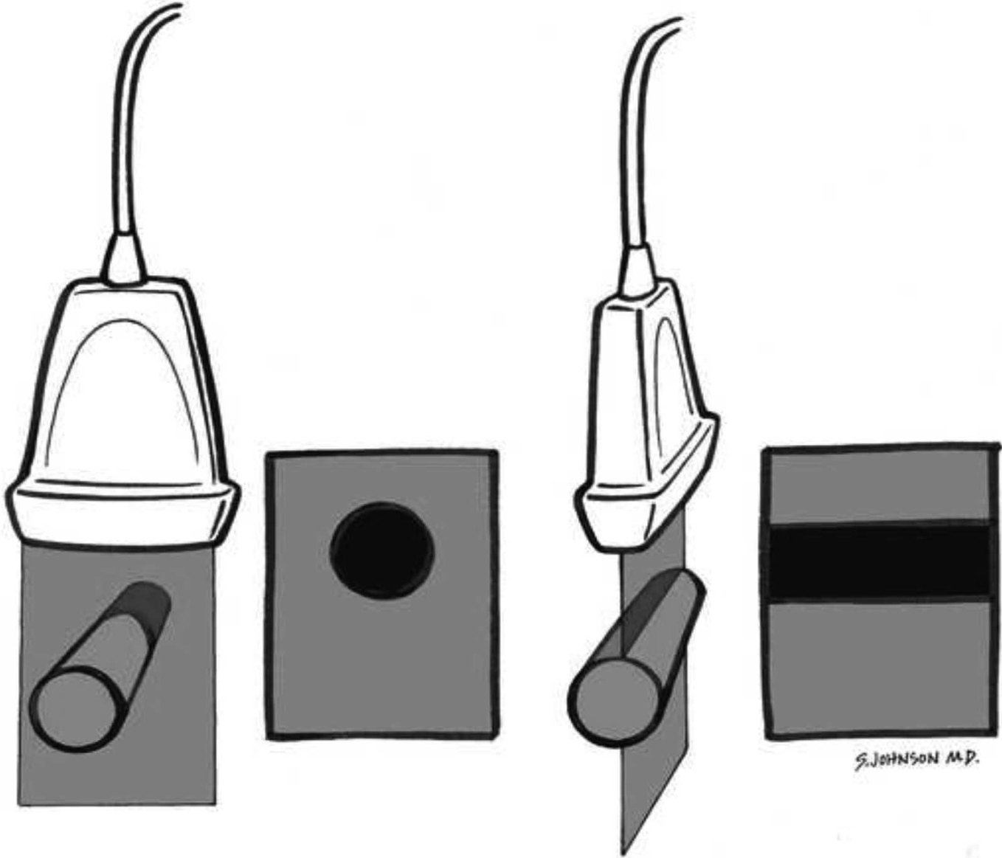
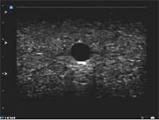
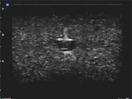
Image 3: The vessel takes up as much of the screen as possible while still allowing identification of its walls..
Image 4: The catheter may push the vessel wall inwards toward the lumen, causing "tenting."
Figure 2. First two images show transducer placement
for short-axis (transverse) view including
how image appears on ultrasound machine screen.
Last two images show transducer placement for
long-axis (longitudinal) view including how image
appears on ultrasound machine screen. Used with
permission from SonoSite® Inc.

Slide 11
Comparison
What alternatives do we want to compare the data to?
Blind sticks/standard technique, infrared vein finders.
Slides needed:
Std vs USGIV: time to treatment, cost, pt satisfaction, infection rates, central line placement rates, % first time attempts.

Slide 12
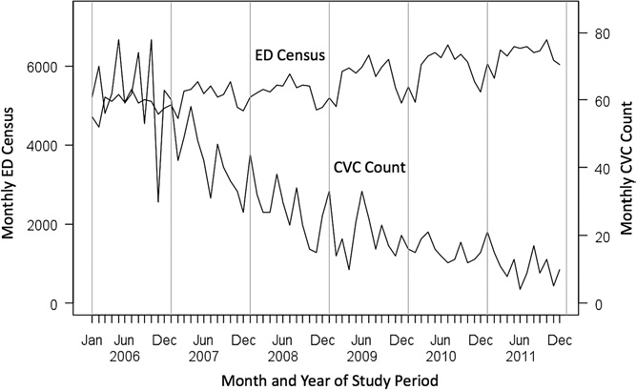
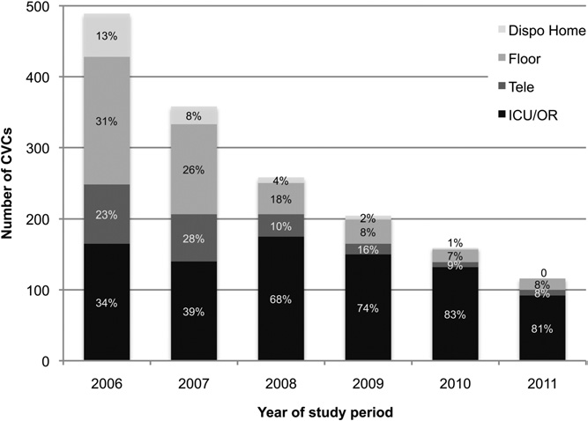
Outcome (Other Facilities)
Figure 1. Total ED volume and total number of central
venous catheters placed, by month throughout the study
period. CVC, Central venous catheter.
Figure 3. Percentage distribution of central venous
catheters placed, by ED disposition and study year. Dispo
Home, Home disposition; Tele, telemetry.

Slide 13
References
Adhikari, S., Morrison D. Comparison of Infection Rates Among Ultrasound Guided-Versus Traditionally Placed Peripheral Intravenous Lines. Journal of Ultrasound Medicine. 29:741-747.
Au, A.K., Rotte, M.J., Grzybowski R.J., Ku, B.S., Fields, J.M. 2012. Decrease in Central Venous Catheter Placement due to Use of Ultrasound Guidance for Peripheral Intravenous Catheters. American Journal of emergency Medicine. 30(9):1950-1954. DOI: 10.1016/j.ajem.2012.04.016.
Bagley, W., Lewiss, R., & Saul, T. et al. (2009, August 1). Focus On: Dynamic Ultrasound-Guided Peripheral Intravenous Line Placement. Retrieved August 22, 2014
Bauman, Michael et al. Ultrasound-guidance vs. standard technique in difficult vascular access patients by ED technicians. The American Journal of Emergency Medicine, Volume 27, Issue 2, 135 – 140.
Brannam, L. Blaivas, M., Lyon, M., Flake, M. 2004. Emergency Nurses’ Utilization of Ultrasound Guidance for Placement of Peripheral Intravenous Lines in Difficult-access Patients”. Academy of Emergency Medicine 11:1361-1363.
Constantino MD, Thomas G. et al. Ultrasonography-Guided Peripheral Intravenous Access Versus Traditional Approaches in Patients With Difficult Intravenous Access. Annals of Emergency Medicine. 46:2 456-461.
Crowley, M. et al. 2011. Clinical Practice Guideline: Difficult Intravenous Access. Emergency Nurses Association
Elia, F. et al. 2012. Standard-length catheters vs. long catheters in ultrasound-guided peripheral vein cannulation. Annals of Emergency Medicine. 30(5):712-716. doi: 10.1016/j.ajem.2011.04.019.
Gregg, S.C., Murthi, S.B., Sisley, A.C., Stein, D.M., Scalea, T.M. 2010. Ultrasound-guided Peripheral Intravenous Access in the Intensive Care Unit. Journal of Critical Care. 25:514-519. doi:10.1016/j.jcrc.2009.09.2003
Keyes, L.E., Frazee, B.W., Snoey, E.R., Simon, B.C., Christy, D. 2009. Ultrasound-guided brachial and basilic vein cannulation in emergency department patients with difficult intravenous access. Annals of Emergency Medicine. 34(6):711-714.
Miles, G., Salcedo, A., Spear, D. 2012. Implementation of a successful Registered Nurse Peripheral Ultrasound-Guided Intravenous Catheter Program in an Emergency Department. Journal of Emergency Nursing. 38(4):353-356.
Moore, C. 2013. An Emergency Department Nurse-Driven Ultrasound-Guided Peripheral Intravenous Line Program. Journal for the Association of Vascular Access. 18(1):45-51.
Moore, C., & Piccirillo, B. et al. (2012, April 1). Use of Ultrasound to Guide Vascular Access Procedures.
Schoenfeld, E. et al. Ultrasound-Guided Peripheral Intravenous Access in the Emergency Department: Patient-Centered Survey. Western Journal of Emergency Medicine. XII: 4 475-477.
Shokoohi MD, H. et al. Ultrasound-Guided Peripheral Intravenous Access Program is Associated With a Marked Reduction in Central Venous Catheter Use in Noncritically Ill Emergency Department Patients. Annals of Emergency Medicine.
Troianos, C., & Hartman, G. et al. (2011). Guidelines for Performing Ultrasound Guided Vascular Cannulation: Recommendations of the American Society of Echocardiography and the Society of Cardiovascular Anesthesiologists. Journal of American Society of Cardiovascular Anasthesiologist, 114((1)), 1291-1318.
White, A., Lopez, F., Stone, P.2010. Developing and Sustaining an Ultrasound-Guided Peripheral Intravenous Access Program for Emergency Nurses. Adv. Emerg Nurs. 32(2):173-188.

