Slide 1
The CAUTI Crusher UTI Action Plan and its Effects on CAUTI Reduction in the Intensive Care Unit
Cindy Hernandez
Mariam yazdi

Slide 2
Abstract
In order to address rates of Catheter Associated Urinary Tract Infections (CAUTIs) in the ICU, a UTI Action Plan was crafted based on researched techniques. ICU team members were educated on the components of the Action Plan and the success of implementation was tracked and analyzed after four months of implementation.

Slide 3
Trends

Slide 4
Project Goals
The UTI Action Plan was instituted August 18th, 2014.
To reduce infections by 15% for the remainder of 2014 (no more than 23 infections)
To reduce infections by 30% by the end of 2015.

Slide 5
UTI Action Plan
UTI Action Plan
Cultivating Enthusiasm
Ongoing Education
Performance Improvement
Inter-professional Collaboration
Increasing Awareness
Early Removal and Catheter Maintenance

Slide 6
Cultivating Enthusiasm
CAUTI Crushers

Slide 7
Ongoing Education
CNAs and Nurse Technicians*
RN Staff
Critical Care Physicians

Slide 8
Increasing Awareness
Bag Labeling
Foley Day #
Rounds

Slide 9
Early Removal and Catheter Maintenance
Remove catheter within two hours of MD order for discontinuation.
Label collection bag with date of insertion.
Place alcohol-based cap on collection port..
Ensure securement device is in place to prevent micro-friction within urethra.
Prevent obstruction of urine within drainage system such as kinks in tubing.
Maintain collection bag less than two-thirds full to prevent excess harboring of bacteria.
Keep collection back bellow level of bladder to prevent back-flow of urine.
Perform catheter care with soap and water every twelve hours and as needed.
Prevent entire collection unit from coming into contact with the floor.

Slide 10
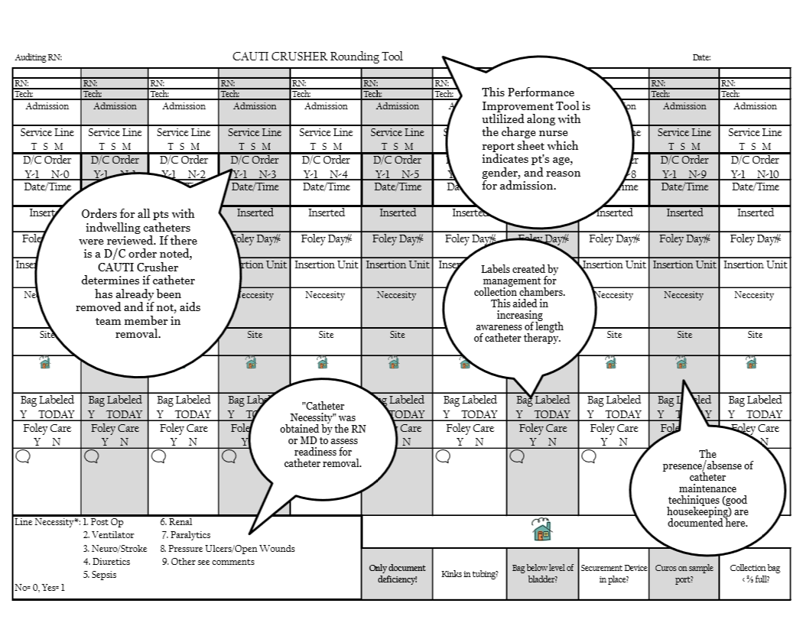
Performance Improvement
Remove catheter within two hours of MD order for discontinuation.
Label collection bag with date of insertion.
Place alcohol-based cap on collection port..
Ensure securement device is in place to prevent micro-friction within urethra.
Prevent obstruction of urine within drainage system such as kinks in tubing.
Maintain collection bag less than two-thirds full to prevent excess harboring of bacteria.
Keep collection back bellow level of bladder to prevent back-flow of urine.
Perform catheter care with soap and water every twelve hours and as needed.
Prevent entire collection unit from coming into contact with the floor.
Remove catheter within two hours of MD order for discontinuation.
Label collection bag with date of insertion.
Place alcohol-based cap on collection port..
Ensure securement device is in place to prevent micro-friction within urethra.
Prevent obstruction of urine within drainage system such as kinks in tubing.
Maintain collection bag less than two-thirds full to prevent excess harboring of bacteria.
Keep collection back bellow level of bladder to prevent back-flow of urine.
Perform catheter care with soap and water every twelve hours and as needed.
Prevent entire collection unit from coming into contact with the floor.

Slide 11
Interprofessional Collaboration
List of Identified Pathogens Related to Catheter-Associated Urinary Tract Infections (CAUTIs)
E. coli
Pseudomonas aeruginosa
Enterococcus faecalis
E. coli ESBL
Klebsiella oxytoca
Acinetobacter baumannii
Enterobacter cloacae
Proteus mirabilis
Serratia arcescens
Staphylococcus epi

Slide 15
Future Objectives
Nurse Driven Protocol for Catheter Removal
Prevention Team

Slide 16
References
Eliminating Catheter-Associated Urinary Tract Infections. Health Research & Educational Trust, Chicago: July 2013. Accessed at www.hpoe.org.
Health and Research Educational Trust; CUSP, Eliminating CAUTI: A National Patient Safety Imperative. (2013). Interim Data Report on the National On the CUSP: Stop CAUTI Project. Retrieved from http://www.ahrq.gov/professionals/quality-patient-safety/cusp/using-cusp-prevention/cauti-interim/cauti-interim.pdf
Martinez-Resendez, MD, M., et al. (2014). Impact of daily chlorhexidine baths and hand hygiene compliance on nosocomial infection rates in critically ill patients. American Journal of Infection Control, 42, 713-717.
Rebmann, T., & Greene, L. (2014). Preventing Catheter-associated Urinary Tract Infections: An Executive Summary Of The Association For Professionals In Infection Control And Epidemiology, Inc, Elimination Guide. American Journal of Infection Control, 644-646.
Strategies to Prevent Catheter‐Associated Urinary Tract Infections in Acute Care Hospitals. (2008). Infection Control and Hospital Epidemiology, Vol. 29(S1). Retrieved August 1, 2014, from http://www.jstor.org/stable/10.1086/591066.

