Slide 1


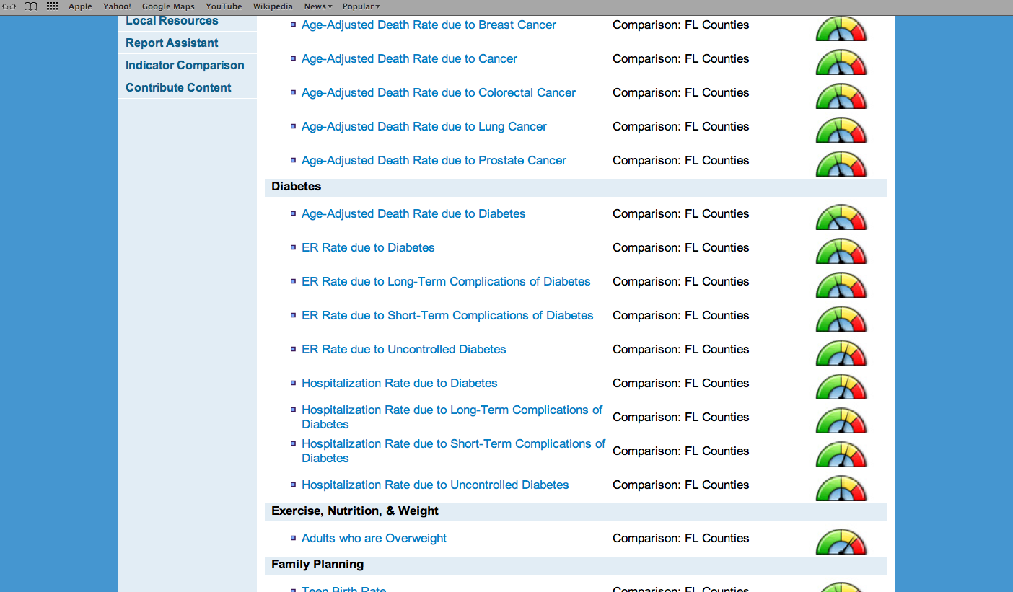
GIS Capabilities
City of El Paso Department of Public Health
Region 15 Regional Health Partnership
1115 Healthcare Transformation Waiver
Border Public Health Interest Group
Fernando J. Gonzalez, Lead Epidemiologist
Region 15 RHP Meeting
March 28, 2014
1:00pm

Slide 2
GIS Capabilities
Description of Project
Synopsis:
The collaborative research group of the three academic institutions in the El Paso area and the City of El Paso Department of Public Health engaged in the collection and analysis of REAL (Race, Ethnicity, and Language) data to describe regional/local health problems and prescribe appropriate policy/program interventions.
Goal:
To express to the broader El Paso region the synergistic value of collaborative research on health topics relevant to border populations.

Slide 3
Border Public Health Research/Community Health Atlas: An Integrated Model for Health Improvement
DPH: HepC
UTEP: Cardio Respiratory
BPHIG
Dental
ATLAS
EP Atlas CMS/HHS Dartmouth Atlas
UTH: Social Determinants
GPS
Fire Stations
School of Medicine: Cancer
DPH Fluid and Tissue Bank
Community: Teen Pregnancy
Policy/Programs
Improved Health
Status

Slide 4
GIS Capabilities
Progress
Five regional research projects identified that will contribute to the study of border health issues.
Inventory of data collection and procedures through site visits with participating institutions to discuss data collection policies and procedures.
-Institutional Review Board
-Human subjects’ certification
-HIPAA
-Quality Improvement
-Information Technology
Information on policies and procedures were requested to the City of El Paso IT Program

Slide 5

Progress
An Organizational/Equipment Plan has been integrated and includes the following components:
Quality Assurance and Control Committee
Organization/Jobs Specifications
City’s Job Specification List
Contractual Schedule 2014
Organization Chart 2014
Cryogenic Storage Equipment 2014
Associate agreements are in the review process with each of the institutions. After consideration returned for final review and signature.
A staffing model has been created, presented and agreed by to maximize efficiency by ensuring staff.

Slide 6

Moving Forward…
Project Milestones
Establish the ongoing mechanisms for accessing the specific information
Identify opportunities for standardization of data collection policies and procedures across participating institutions.

